Slide 1
Instruction-Level Parallelism Static Parallelism
06
Kai Bu
kaibu@zju.edu.cn
http://list.zju.edu.cn/kaibu/comparch2022

Slide 2
Instruction-Level Parallelism

Slide 3
ILP
Notes:
Referred to as ILP for short

Slide 4
ILP: Pipelining
Notes:
Typical technique: pipelining

Slide 5
ILP: Pipelining!
all processors since 1985 have used pipelining to improve performance

Slide 6
ILP: Pipelining?
Notes:
So, what is pipelining?

Slide 7
ILP: Pipelining?
you already knew!
Notes:
So, what is pipelining?

Slide 8
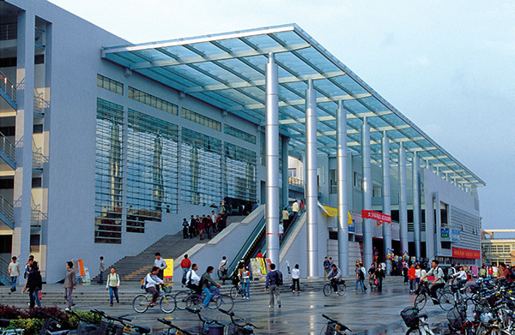
Cafeteria:
kinda miss zjg?
Notes:
Which cafeteria did you go for lunch today?

Slide 9
Cafeteria:
Did you wait until all others finish?
kinda miss zjg?
Notes:
Did u wait until all other students before you finish?
Apparently not; after we enter the cafeteria,

Slide 10

Cafeteria:
Order
Notes:
Queue, to order first

Slide 11

Cafeteria:
Pay
Notes:
Pay for what u order

Slide 12

Cafeteria:
Enjoy
Notes:
Then find a table, start enjoying the meal with your classmates

Slide 13
Cafeteria:
Enjoy
while some others are
Ordering or Paying
Notes:
While some other students are still ordering and paying.

Slide 14
Cafeteria:
Observations?
Notes:
From this cafeteria example, what do you observe?

Slide 15
Cafeteria:
Observations?
besides eating 23333
Ordering or Paying

Slide 16
Cafeteria:
Observations?
co-use dependent function areas
speed up the dining process of all
Notes:
Divide the dining process (of each student) into sub-processes;
For each sub-process, allocate dependent function areas;
These function areas can be co-used – by different students;
Speed up the dining process of all students;

Slide 17
Cafeteria:
Observations?
individual perspective?
speed up the dining process of all
order
pay
enjoy
Notes:
Observations from individual perspective
That is, as a student, how this sharing fashion affects you, do you take shorter time or longer time to finish lunch?

Slide 18
Cafeteria:
Observations?
individual perspective?
speed up the dining process of all
fastest if only one to server
order
pay
enjoy
Notes:
Apparently, if you are the only one to serve
You can take the shortest time to finish, as at each step, you don’t need to wait for any one;

Slide 19

Cafeteria:
Observations?
individual perspective?
speed up the
fastest if only one to server
order
pay
enjoy
…… a potentially very, very long queue
Notes:
Apparently, if you are the only one to serve
You can take the shortest time to finish, as at each step, you don’t need to wait for any one;

Slide 20

Cafeteria:
Observations?
individual perspective?
fastest if only one to server
order
pay
enjoy
…… a potentially very, very long queue
Notes:
Apparently, if you are the only one to serve
You can take the shortest time to finish, as at each step, you don’t need to wait for any one;

Slide 21
Cafeteria:
Observations
Average - faster
Individual – slower (service time)
but much less time in queue
Individual – faster: queue + service

Slide 22
(classic) laundry example
Notes:
The laundry example is a classic one for us to kick off the discussion of pipelining,
although it’s more applicable to western universities,

Slide 23
Laundry Example
Ann, Brian, Cathy, Dave
Each has one load of clothes to
wash, dry, fold.
washer
30 mins
dryer
40 mins
folder
20 mins
Notes:
Say four students each with a load of clothes to wash, dry, and fold.
The washer takes 30 mins, dryer 40 mins, and folder 20 mins.

Slide 24
Sequential Laundry
6 Hours
Time
30 40 20
30 40 20
30 40 20
30 40 20
A
Task Order
B
C
D
What would you do?
Notes:
When they do the laundry in a sequential fashion, A does the laundry first, and only after A completes can B start. Similarly, C after B, and D after C.
Obviously, in this case, the sequential laundry will take up to 6 hours.
But the question is, would you do it like this in real life? Actually, after A uses the washer, B can immediately start washing without further waiting.

Slide 25
Sequential Laundry
6 Hours
Time
30 40 20
30 40 20
30 40 20
30 40 20
A
Task Order
B
C
D
What would you do?
Notes:
And then B can start drying after A finishes drying, and start folding after A finishes folding.

Slide 26
Pipelined Laundry
3.5 Hours
Time
30 40 40
40 40 20
A
Task Order
B
C
D
Notes:
Following this way, the laundry task execution will look like this. We call such laundry execution pipelined laundry, in which a laundry task can start before previous one completes.
The pipelined laundry takes only 3 and a half hours, which is much shorter than 6 hours taken by the sequential laundry.
Before we delve into the definition of pipelining in computer architecture, let’s see what observations we can get from this pipelined laundry example.
First, a task has a series of stages. For example, a laundry task here has three stages, washing, drying, and folding.
Second, connecting stages have dependency upon each other. For example, you need to wash clothes before you dry them.
When there are multiple tasks to run, simultaneously using different resources can accelerate the execution.
A deeper observation is that the slowest stage determines the finish time. In this example, the dryer takes the longest time of 40 mins. And it’s obvious that the dryer decides when the last task will finish.

Slide 27
Pipelined Laundry
3.5 Hours
Observations
A task has a series of stages;
Time
30 40 40
40 40 20
A
Task Order
B
C
D
Notes:
Following this way, the laundry task execution will look like this. We call such laundry execution pipelined laundry, in which a laundry task can start before previous one completes.
The pipelined laundry takes only 3 and a half hours, which is much shorter than 6 hours taken by the sequential laundry.
Before we delve into the definition of pipelining in computer architecture, let’s see what observations we can get from this pipelined laundry example.
First, a task has a series of stages. For example, a laundry task has three stages, washing, drying, and folding.
Second, connecting stages have dependency upon each other. For example, you need to wash clothes before you dry them.
When there are multiple tasks to run, simultaneously using different resources can accelerate the execution.
A deeper observation is that the slowest stage determines the finish time. In this example, the dryer takes the longest time of 40 mins. And it’s obvious that the dryer decides when the last task will finish.

Slide 28
Pipelined Laundry
3.5 Hours
Observations
A task has a series of stages;
Stage dependency:
e.g., wash before dry;
Time
30 40 40
40 40 20
A
Task Order
B
C
D
Notes:
Following this way, the laundry task execution will look like this. We call such laundry execution pipelined laundry, in which a laundry task can start before previous one completes.
The pipelined laundry takes only 3 and a half hours, which is much shorter than 6 hours taken by the sequential laundry.
Before we delve into the definition of pipelining in computer architecture, let’s see what observations we can get from this pipelined laundry example.
First, a task has a series of stages. For example, a laundry task has three stages, washing, drying, and folding.
Second, connecting stages have dependency upon each other. For example, you need to wash clothes before you dry them.
When there are multiple tasks to run, simultaneously using different resources can accelerate the execution.
A deeper observation is that the slowest stage determines the finish time. In this example, the dryer takes the longest time of 40 mins. And it’s obvious that the dryer decides when the last task will finish.

Slide 29
Pipelined Laundry
3.5 Hours
Observations
A task has a series of stages;
Stage dependency:
e.g., wash before dry;
Multi tasks with overlapping stages;
Time
30 40 40
40 40 20
A
Task Order
B
C
D
Notes:
When there are multiple tasks to run, simultaneously using different resources can accelerate the execution.
A deeper observation is that the slowest stage determines the finish time. In this example, the dryer takes the longest time of 40 mins. And it’s obvious that the dryer decides when the last task will finish.

Slide 30
Pipelined Laundry
3.5 Hours
Observations
A task has a series of stages;
Stage dependency:
e.g., wash before dry;
Multi tasks with overlapping stages;
Simultaneously use diff resources to speed up;
Time
30 40 40
40 40 20
A
Task Order
B
C
D
Notes:
Following this way, the laundry task execution will look like this. We call such laundry execution pipelined laundry, in which a laundry task can start before previous one completes.
The pipelined laundry takes only 3 and a half hours, which is much shorter than 6 hours taken by the sequential laundry.
Before we delve into the definition of pipelining in computer architecture, let’s see what observations we can get from this pipelined laundry example.
First, a task has a series of stages. For example, a laundry task has three stages, washing, drying, and folding.
Second, connecting stages have dependency upon each other. For example, you need to wash clothes before you dry them.
When there are multiple tasks to run, simultaneously using different resources can accelerate the execution.
A deeper observation is that the slowest stage determines the finish time. In this example, the dryer takes the longest time of 40 mins. And it’s obvious that the dryer decides when the last task will finish.

Slide 31
Pipelined Laundry
3.5 Hours
Observations
A task has a series of stages;
Stage dependency:
e.g., wash before dry;
Multi tasks with overlapping stages;
Simultaneously use diff resources to speed up;
Slowest stage determines the finish time;
Time
30 40 40
40 40 20
A
Task Order
B
C
D
Notes:
A deeper observation is that the slowest stage determines the finish time. In this example, the dryer takes the longest time of 40 mins. And it’s obvious that the dryer decides when the last task will finish.

Slide 32
Pipelined Laundry
3.5 Hours
Observations
No speed up for individual task;
e.g., A still takes 30+40+20=90
Time
30 40 40
40 40 20
A
Task Order
B
C
D
Notes:
Another important observation is that an individual task doesn’t become faster. For example. A still takes 90 mins for laundry.
On the contrary, it’s the average task execution time that becomes much shorter. In this case, four tasks take 3 and a half hours, with each taking about 52 mins, which is much shorter than the original 90 mins.

Slide 33
Pipelined Laundry
3.5 Hours
Observations
No speedup for individual task;
e.g., A still takes 30+40+20=90
But speedup for average task execution time;
e.g., 3.5*60/4=52.5 < 30+40+20=90
Time
30 40 40
40 40 20
A
Task Order
B
C
D
Notes:
Another important observation is that an individual task doesn’t become faster. For example. A still takes 90 mins for laundry.
On the contrary, it’s the average task execution time that becomes much shorter. In this case, four tasks take 3 and a half hours, with each taking about 52 mins, which is much shorter than the original 90 mins.

Slide 34
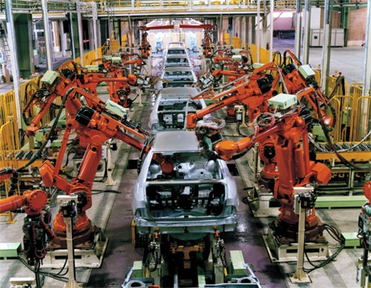
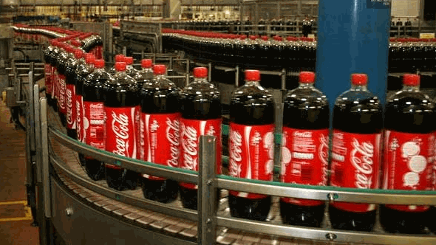
Pipeline Elsewhere: Assembly Line
Cola
Auto
Notes:
Another example analogous to pipelining is assembly line where many products can be assembled at the same time.
(In an automobile assembly line, there are many steps, each contributing something to the construction of the car. Each step operates in parallel with the other steps, although on a different car.)

Slide 35
What exactly is pipelining in computer arch?
Notes:
Now, with these background, we can officially proceed to the principles of pipelining in computer world.

Slide 36
Pipelining
An implementation technique whereby multiple instructions are overlapped in execution.
e.g., B wash while A dry
Essence: Start executing one instruction before completing the previous one.
Significance: Make fast CPUs.
A
B
Notes:
Pipelining is an implementation technique whereby multiple instructions are overlapped in execution. Take the pipelined laundry for example. B uses the washer while A uses the dryer.
Its essence is to start executing one instruction before completing the previous one. And its significance is therefore to make fast CPUs.
(In a computer pipeline, each step in the pipeline completes a part of an instruction. Like the assembly line, different steps are completing different parts of different instructions in parallel.
Each of these steps is called a pipe stage or a pipe segment.
The stages are connected on to the next to form a piple. Instructions enter at one end, progress through the stages, and exit at the other end.)

Slide 37
Emm, (in)Equality
3.5 Hours
Observations
A task has a series of stages;
Stage dependency:
e.g., wash before dry;
Multi tasks with overlapping stages;
Simultaneously use diff resources to speed up;
Slowest stage determines the finish time;
Time
30 40 40
40 40 20
A
Task Order
B
C
D
Notes:
A deeper observation is that the slowest stage determines the finish time. In this example, the dryer takes the longest time of 40 mins. And it’s obvious that the dryer decides when the last task will finish.

Slide 38
(ideal) Balanced Pipeline
Equal-length pipe stages/segments
e.g., Wash, dry, fold = 40 mins
per unpipelined laundry time = 40x3 mins
3 pipe stages – wash, dry, fold
40min
T1
A
T2
B
A
T3
C
B
A
T4
D
C
B
Notes:
The ideal case for pipelining is balanced pipeline. In a balanced pipeline, all pipe stages have equal duration.
Consider again the laundry example with each stage taking 40 mins. Then the unpipelined laundry will take 40 times 3 mins to finish one task.
Now let’s recap how pipelined laundry will perform the four tasks.
In the first time duration T1, A uses the washer; In T2, A uses the dryer while B uses the washer; In T3, A uses the folder, B uses the dryer, while C uses the washer. Starting from T3, all resources are fully used in the same duration. Then the pipelined laundry takes 40 mins on average to complete one task. Based on this observation, we have two performance properties of balanced pipeline. One is the time per instruction by pipeline is equal to time per instruction on unpipelined machine over the number of pipe stages. The other is speed up by pipeline is equal to the number of pipe stages.

Slide 39
Balanced Pipeline
One task/instruction
per 40 mins
Equal-length pipe stages
e.g., Wash, dry, fold = 40 mins
per unpipelined laundry time = 40x3 mins
3 pipe stages – wash, dry, fold
Performance
Time per instruction by pipeline =
Time per instr on unpipelined machine
Number of pipe stages
Speed up by pipeline =
Number of pipe stages
40min
T1
A
T2
B
A
T3
C
B
A
T4
D
C
B
Notes:
In T3, A uses the folder, B uses the dryer, while C uses the washer.
Starting from T3, all resources are fully used in the same duration. Then the pipelined laundry takes 40 mins on average to complete one task. Based on this observation, we have two performance properties of balanced pipeline. One is the time per instruction by pipeline is equal to time per instruction on unpipelined machine over the number of pipe stages. The other is speed up by pipeline is equal to the number of pipe stages.

Slide 40
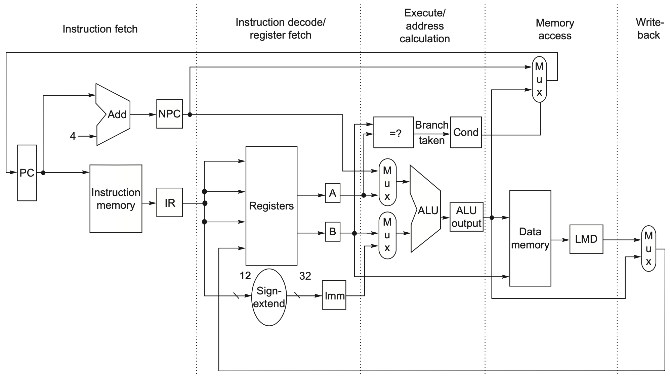
Example RISC-V Data Path
Notes:
Figure C.18 The implementation of the RISC V data path allows every instruction to be executed in 4 or 5 clock cycles. Although the PC is shown in the portion of the data path that is used in instruction fetch and the registers are shown in the portion of the data path that is used in instruction decode/register fetch, both of these functional units are read as well as written by an instruction. Although we show these functional units in the cycle corresponding to where they are read, the PC is written during the memory access clock cycle and the registers are written during the write-back clock cycle. In both cases, the writes in later pipe stages are indicated by the multiplexer output (in mem- ory access or write-back), which carries a value back to the PC or registers. These backward-flowing signals introduce much of the complexity of pipelining, because they indicate the possibility of hazards.

Slide 41
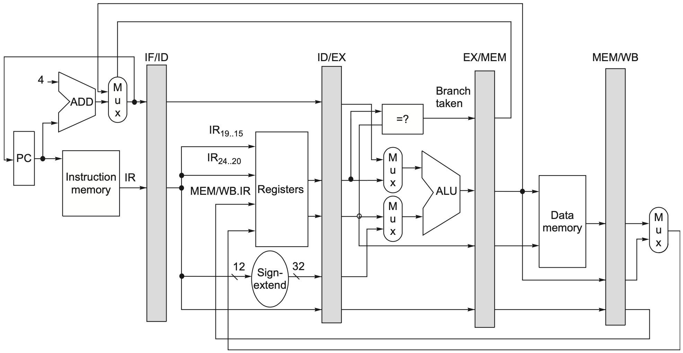
Example RISC-V Data Path
Pipelined
Notes:
Figure C.19 The data path is pipelined by adding a set of registers, one between each pair of pipe stages. The registers serve to convey values and control information from one stage to the next. We can also think of the PC as a pipeline register, which sits before the IF stage of the pipeline, leading to one pipeline register for each pipe stage. Recall that the PC is an edge-triggered register written at the end of the clock cycle; hence, there is no race condition in writing the PC. The selection multiplexer for the PC has been moved so that the PC is written in exactly one stage (IF). If we didn’t move it, there would be a conflict when a branch occurred, because two instructions would try to write different values into the PC. Most of the data paths flow from left to right, which is from earlier in time to later. The paths flowing from right to left (which carry the register write-back information and PC information on a branch) introduce complications into our pipeline.
To control this simple pipeline we need only determine how to set the con- trol for the four multiplexers in the data path of Figure C.19. The two multi- plexers in the ALU stage are set depending on the instruction type, which is dictated by the IR field of the ID/EX register. The top ALU input multiplexer is set by whether the instruction is a branch or not, and the bottom multiplexer is set by whether the instruction is a register-register ALU operation or any other type of operation. The multiplexer in the IF stage chooses whether to use the value of the incremented PC or the value of the EX/MEM.ALUOutput (the branch target) to write into the PC. This multiplexer is controlled by the field EX/MEM.cond. The fourth multiplexer is controlled by whether the instruction in the WB stage is a load or an ALU operation. In addition to these four mul- tiplexers, there is one additional multiplexer needed that is not drawn in Figure C.19, but whose existence is clear from looking at the WB stage of an ALU operation. The destination register field is in one of two different places depending on the instruction type (register-register ALU versus either ALU immediate or load). Thus, we will need a multiplexer to choose the correct por- tion of the IR in the MEM/WB register to specify the register destination field, assuming the instruction writes a register.

Slide 42
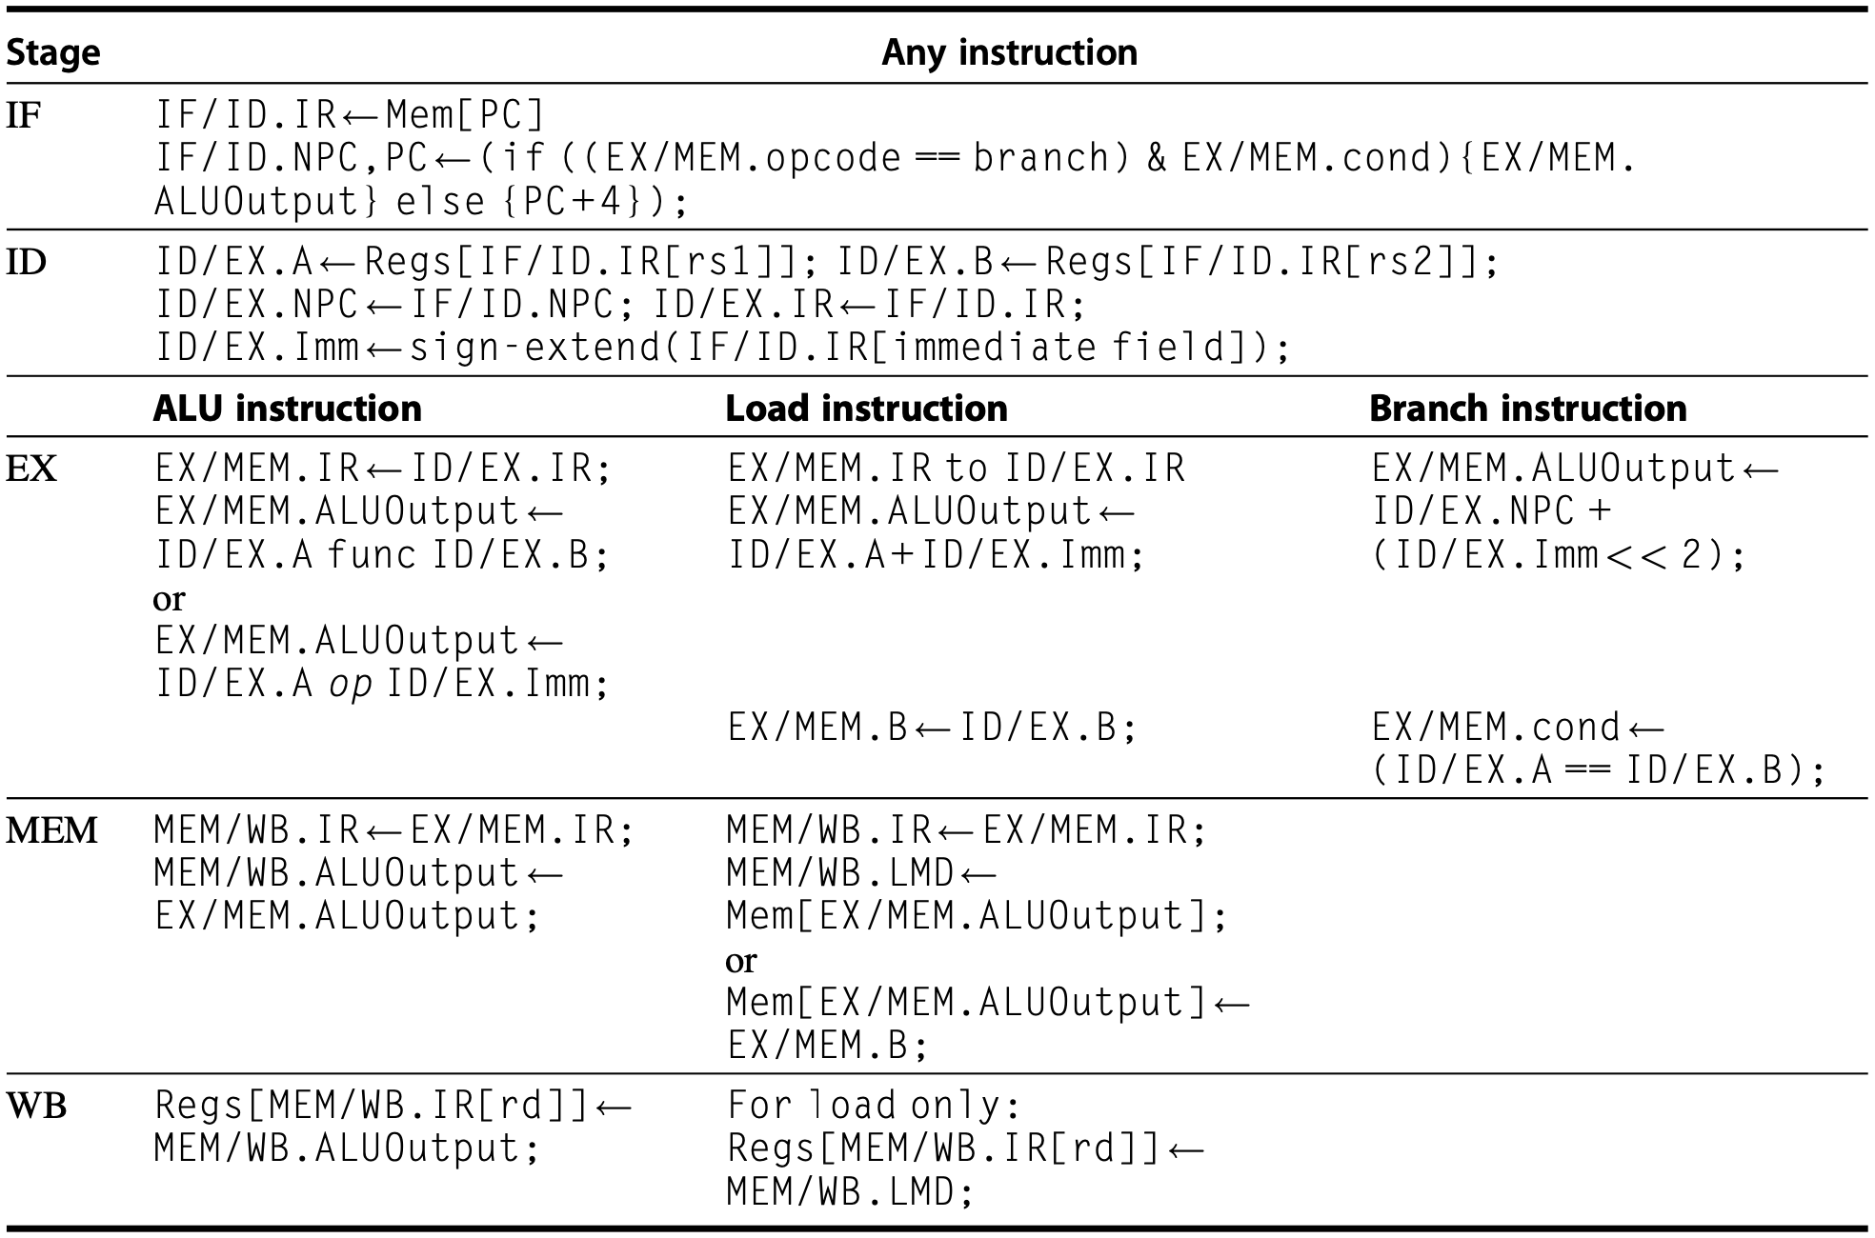
Example RISC-V Data Path
Pipelined
Notes:
FigureC.20 EventsoneverypipestageoftheRISCVpipeline.Let’sreviewtheactionsinthestagesthatarespecific to the pipeline organization. In IF, in addition to fetching the instruction and computing the new PC, we store the incremented PC both into the PC and into a pipeline register (NPC) for later use in computing the branch-target address. This structure is the same as the organization in Figure C.19, where the PC is updated in IF from one of two sources. In ID, we fetch the registers, extend the sign of the 12 bits of the IR (the immediate field), and pass along the IR and NPC. During EX, we perform an ALU operation or an address calculation; we pass along the IR and the B register (if the instruction is a store). We also set the value of cond to 1 if the instruction is a taken branch. During the MEM phase, we cycle the memory, write the PC if needed, and pass along values needed in the final pipe stage. Finally, during WB, we update the register field from either the ALU output or the loaded value. For simplicity we always pass the entire IR from one stage to the next, although as an instruction proceeds down the pipeline, less and less of the IR is needed.

Slide 43
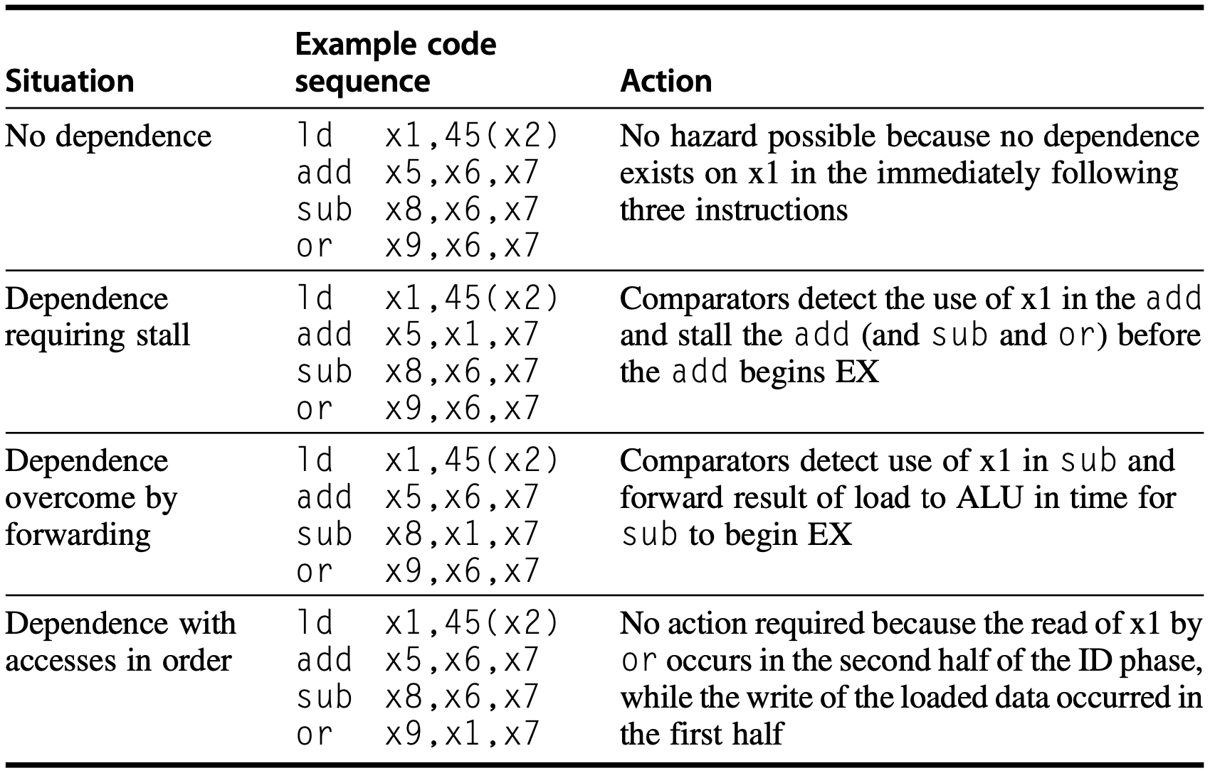
Data Hazard & Forwarding
hazard detection by comparing
the destination and sources of adjacent instructions
Notes:
FigureC.21 Situations that the pipeline hazard detection hardware can see by comparing the destination and sources of adjacent instructions. This table indicates that the only comparison needed is between the destination and the sources on the two instructions following the instruction that wrote the destination. In the case of a stall, the pipeline dependences will look like the third case once execution continues (dependence overcome by forwarding). Of course, hazards that involve x0 can be ignored because the register always contains 0, and the preceding test could be extended to do this.

Slide 44
Data Hazard & Forwarding
hazard detection by comparing
the destination and sources of adjacent instructions
Notes:
FigureC.21 Situations that the pipeline hazard detection hardware can see by comparing the destination and sources of adjacent instructions. This table indicates that the only comparison needed is between the destination and the sources on the two instructions following the instruction that wrote the destination. In the case of a stall, the pipeline dependences will look like the third case once execution continues (dependence overcome by forwarding). Of course, hazards that involve x0 can be ignored because the register always contains 0, and the preceding test could be extended to do this.

Slide 45
Data Hazard & Forwarding
hazard detection by comparing
the destination and sources of adjacent instructions
Notes:
FigureC.21 Situations that the pipeline hazard detection hardware can see by comparing the destination and sources of adjacent instructions. This table indicates that the only comparison needed is between the destination and the sources on the two instructions following the instruction that wrote the destination. In the case of a stall, the pipeline dependences will look like the third case once execution continues (dependence overcome by forwarding). Of course, hazards that involve x0 can be ignored because the register always contains 0, and the preceding test could be extended to do this.

Slide 46
Data Hazard & Forwarding
hazard detection by comparing
the destination and sources of adjacent instructions
Notes:
FigureC.21 Situations that the pipeline hazard detection hardware can see by comparing the destination and sources of adjacent instructions. This table indicates that the only comparison needed is between the destination and the sources on the two instructions following the instruction that wrote the destination. In the case of a stall, the pipeline dependences will look like the third case once execution continues (dependence overcome by forwarding). Of course, hazards that involve x0 can be ignored because the register always contains 0, and the preceding test could be extended to do this.

Slide 47
Data Hazard & Forwarding
hazard detection by comparing
the destination and sources of adjacent instructions
Notes:
FigureC.21 Situations that the pipeline hazard detection hardware can see by comparing the destination and sources of adjacent instructions. This table indicates that the only comparison needed is between the destination and the sources on the two instructions following the instruction that wrote the destination. In the case of a stall, the pipeline dependences will look like the third case once execution continues (dependence overcome by forwarding). Of course, hazards that involve x0 can be ignored because the register always contains 0, and the preceding test could be extended to do this.

Slide 48
Data Hazard & Forwarding
hazard detection by comparing
the destination and the sources on the two instructions
following the instruction that wrote the destination
Notes:
FigureC.21 Situations that the pipeline hazard detection hardware can see by comparing the destination and sources of adjacent instructions. This table indicates that the only comparison needed is between the destination and the sources on the two instructions following the instruction that wrote the destination. In the case of a stall, the pipeline dependences will look like the third case once execution continues (dependence overcome by forwarding). Of course, hazards that involve x0 can be ignored because the register always contains 0, and the preceding test could be extended to do this.

Slide 49
Data Hazard & Forwarding
Notes:
lab01, xixi
forwarding logic

Slide 50
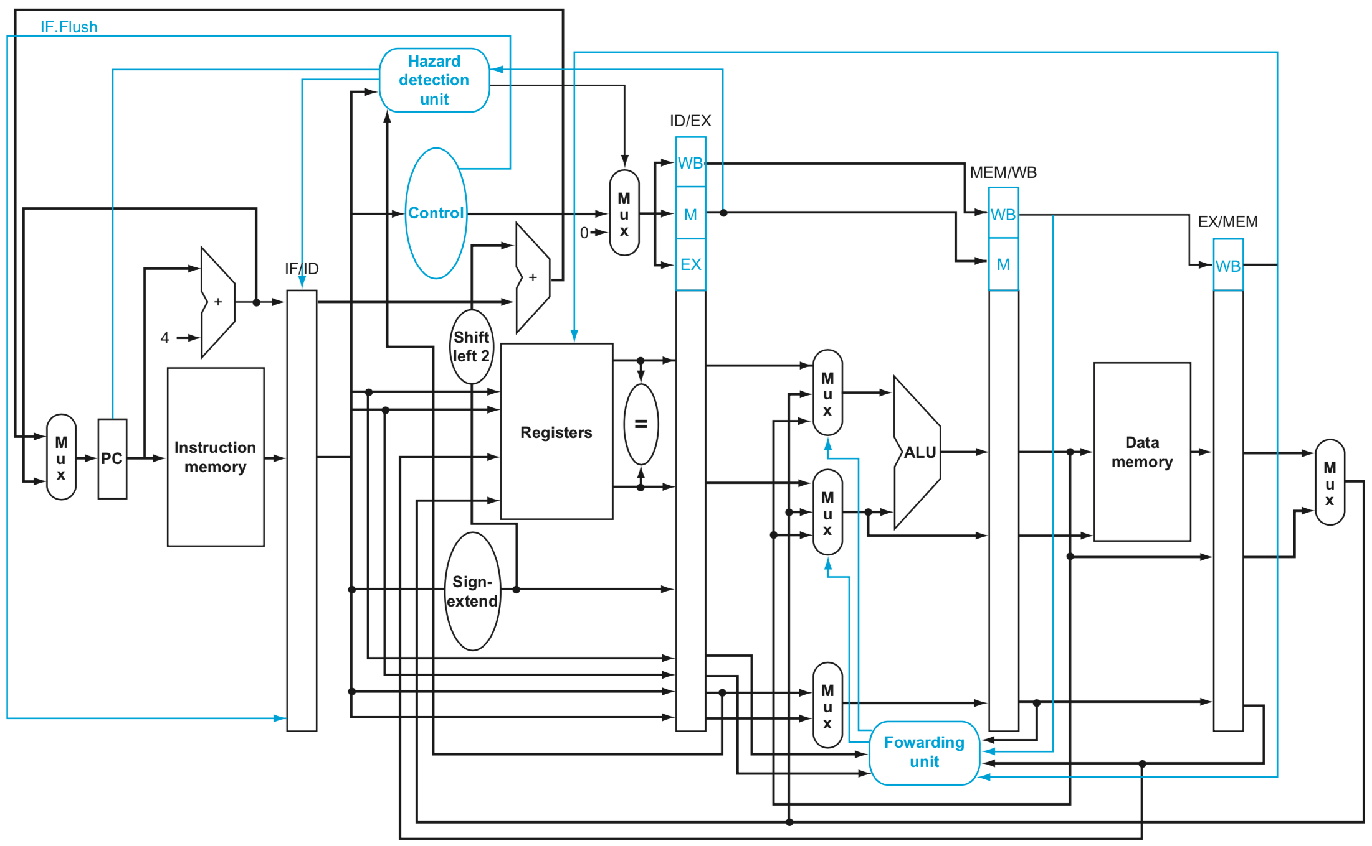
Integer Op in 1 CC
IF ID EX MEM WB
Notes:
In previous discussions, we consider only integer operations.
For each stage, operation completes in one clock cycle

Slide 51
What about
floating-point operation?

Slide 52
FP Operation
Floating-point (FP) operations take more time than integer operations do
To complete an FP op in 1 cc?
Notes:
Floating-point operations take more time than integer operations do;
Then if we still want the pipeline to complete an FP operation in one clock cycle? What should we do?

Slide 53
FP Operation
Floating-point (FP) operations take more time than integer operations do
To complete an FP op in 1 cc:
a slow clock?
Notes:
We could use a slow clock, right? Such that the time duration of a clock cycle will be longer, if it is long enough to finish any FP operation, then we can complete an FP in one clock cycle.
What else / any other solutions?

Slide 54
FP Operation
Floating-point (FP) operations take more time than integer operations do
To complete an FP op in 1 cc:
a slow clock?
many logic in FP units?
Notes:
With the time duration of a clock cycle being the same, we can enrich the computation power of FP units by mounting many more computation logic in them.
Using such complex design, we may complete an FP operation much faster such that it fits in one clock cycle that is short enough to finish an integer operation.
Now seems that we can easily extend our pipeline to support FP operations. What do u think? Do you consider it feasible if we simply adopt one of these two solutions?
For example, if we simply tune to a slow clock,

Slide 55
FP Operation
Floating-point (FP) operations take more time than integer operations do
To complete an FP op in 1 cc:
a slow clock?
many logic in FP units?
Notes:
what’s the downside?

Slide 56
FP Operation
Floating-point (FP) operations take more time than integer operations do
To complete an FP op in 1 cc:
a slow clock? slow down integer ops
many logic in FP units?
Notes:
It’ll slow down integer operations.
As an integer operation takes a shorter time to complete than an FP operation does, if we simply stretch the clock cycle to support slower FP operations, integer operations will waste some time in each clock cycle just waiting for the clock cycle to end.

Slide 57
FP Operation
Floating-point (FP) operations take more time than integer operations do
To complete an FP op in 1 cc:
a slow clock? slow down integer ops
many logic in FP units?
Notes:
What about putting more computation logic in FP units?

Slide 58
FP Operation
Floating-point (FP) operations take more time than integer operations do
To complete an FP op in 1 cc:
a slow clock? slow down integer ops
many logic in FP units? manufacturing
hardness & expensiveness
Notes:
This challenges the manufacturing process.

Slide 59
Then how?

Slide 60
Multicycle FP Operation
FP pipeline
allow for a longer latency for op;
i.e., take >1 cc for EXE;
two changes over integer pipeline:
repeat EX;
use multiple FP functional units;
e.g., FP adder, FP divider
Notes:
For manufacturing easiness, we need to compromise the speed requirement, that is, an FP operation does not necessarily have to be completed in one clock cycle.
In other words, we allow for a longer latency for FP operations, say, take more than one clock cycle for the execution stage;
Following this design principle, two changes over integer pipeline:
The first is repeat EX. Since EX stage takes more than one clock cycle, the component responsible for EX may be repeatedly used in each clock cycle.
The second is use multiple FP functional units, each of which is specialized for a certain type of operation such as addition and division.
It does not simply mix all types of computation logic into one component, easing the manufacturing process.

Slide 61
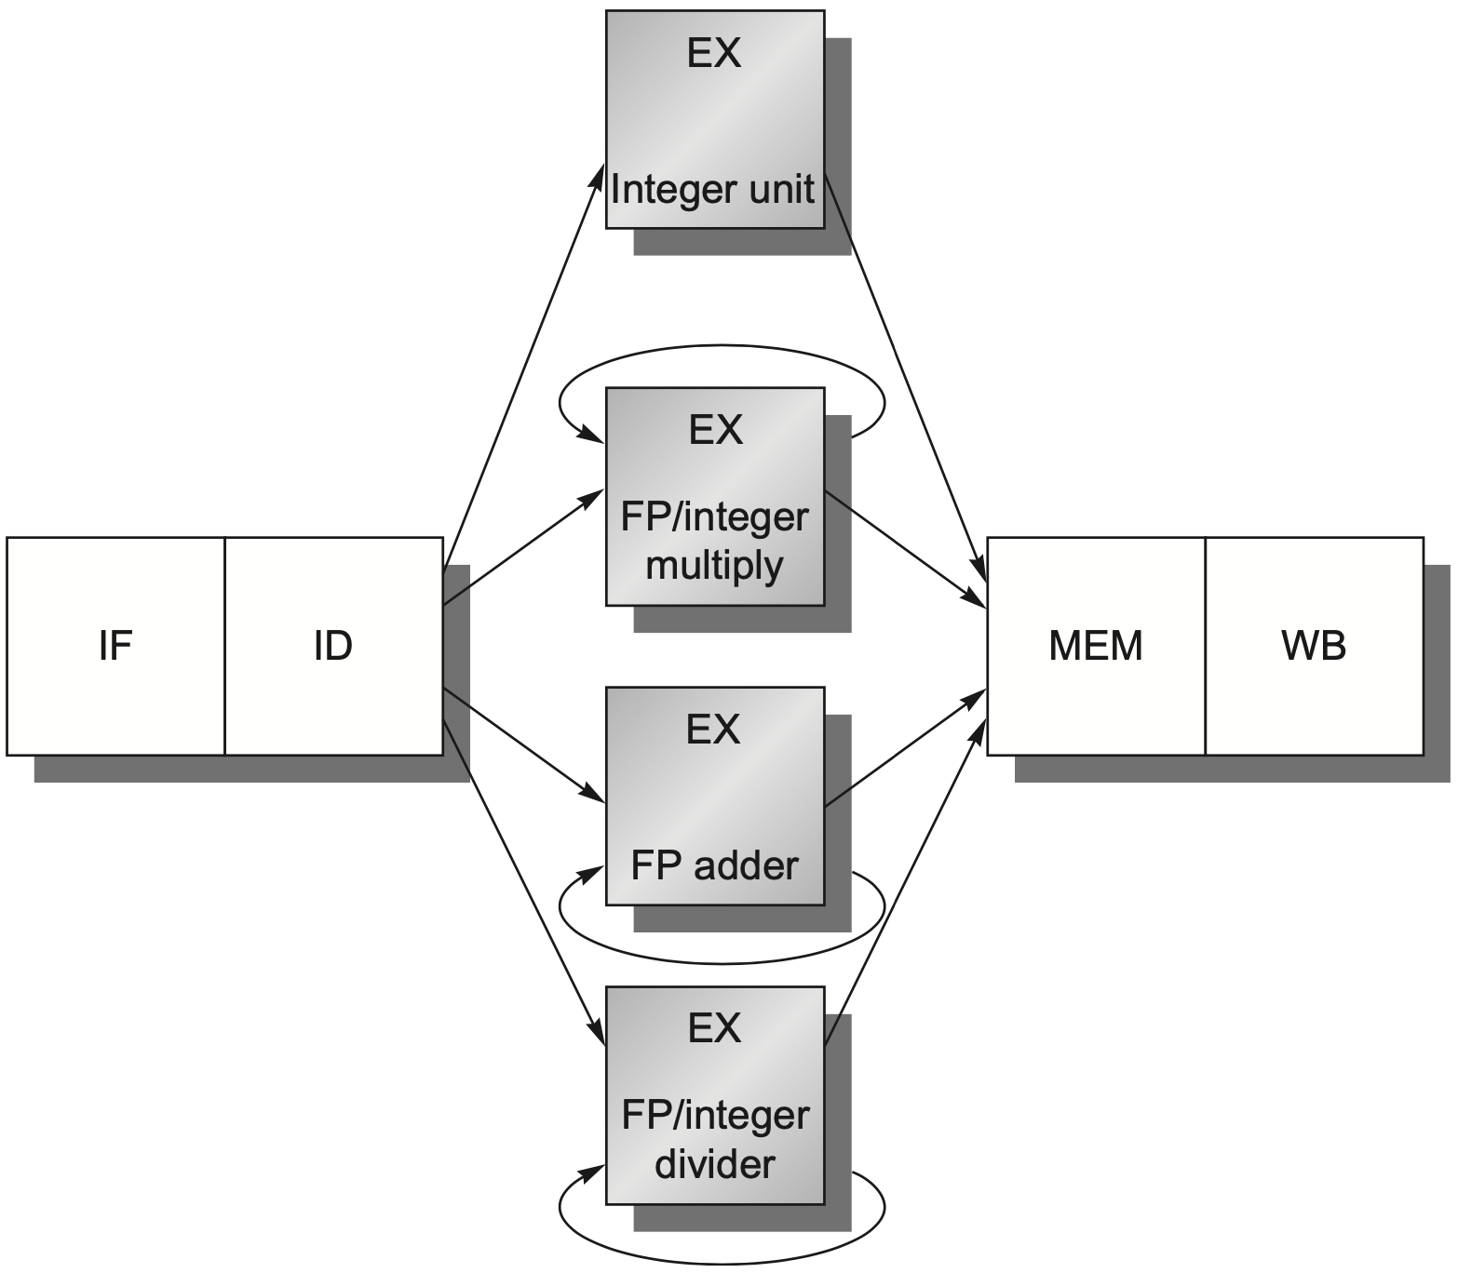
FP Pipeline
Notes:
The architecture supporting FP operations,
In comparison with integer pipeline, several more functional units are added.

Slide 62
FP Pipeline
how?
Notes:
How it works for supporting FP operations?

Slide 63
FP Pipeline
loads and stores
integer ALU operations
branches
use multiple FP units
FP and integer multiplier
repeat EX
FP add
FP subtract
FP conversion
FP and integer divider
Notes:
Each functional unit for certain types of operations;

Slide 64
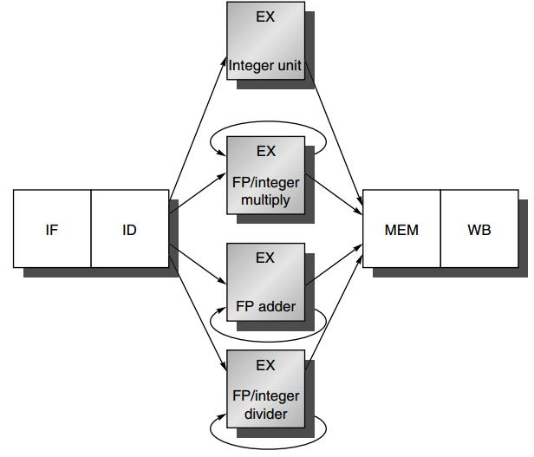
FP Pipeline
EX is not pipelined
Until the previous instruction leaves EX, no other instruction using that functional unit may issue
If an instruction cannot proceed to EX, the entire pipeline
behind that instruction will be stalled
ID → EX
curious about out-of-order execution?!
Notes:
Apparently, now an FP operation may repeat EX several times to complete, it’s not feasible to allow a subsequent instruction to enter EX one clock cycle after another.
This requires that EX is not pipelined. Until the previous instruction leaves EX, no other instruction using that functional unit may issue.
(still remember the concept of Instruction Issue?)

Slide 65
Latency & Ini/Repeat Interval
Latency
the number of intervening cycles between an instruction that produces a result and an instruction that uses the result
Initiation/Repeat Interval
the number of cycles that must elapse between issuing two operations of a given type

Slide 66
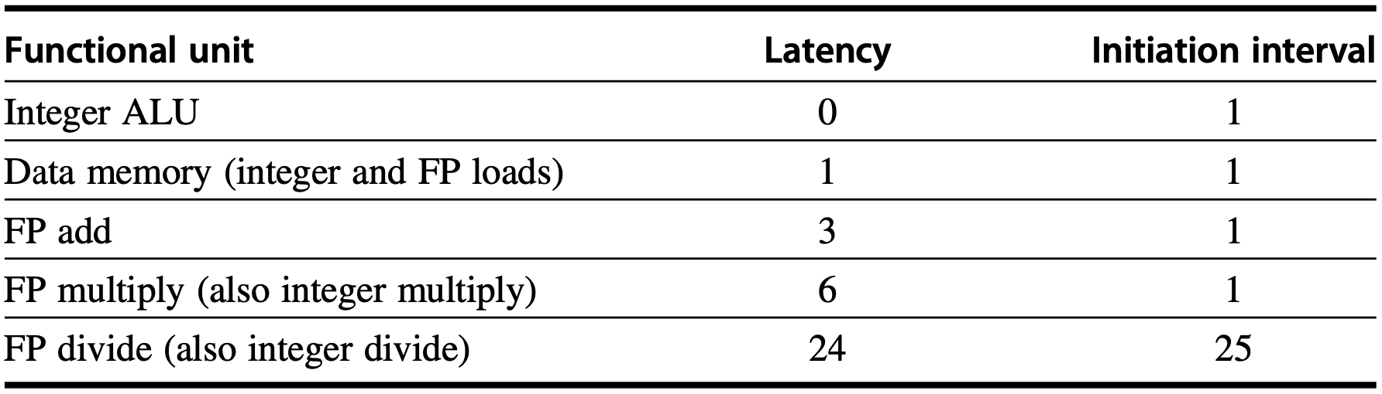
Latency & Ini/Repeat Interval
Essentially, pipeline latency is
1 cycle less than
the depth of the execution pipeline,
which is the number of stages from the
EX stage to the stage that produces the result
Notes:
Since most operations consume their operands at the beginning of EX,
The latency is usually the number of stages after EX that an instruction produces a result:
For example:
0 stages for ALU operations and one stage for loads

Slide 67
Latency & Ini/Repeat Interval
Two (dependent) integer ALU instructions:
ADD R3, R1, R2 pipeline diagram
ADD R5, R3, R4
EX
EX
Notes:
Latency
the number of intervening cycles between an instruction that produces a result and an instruction that uses the result
Initiation/Repeat Interval
the number of cycles that must elapse between issuing two operations of a given type

Slide 68
Latency & Ini/Repeat Interval
Two (dependent) integer ALU instructions:
ADD R3, R1, R2 pipeline diagram
ADD R5, R3, R4
Latency: 0
as no intervention to pipeline
EX
EX
Notes:
Integer ALU operations have a latency of 0, since the results can be used on the next clock cycle (without any intervening cycle)

Slide 69
Latency & Ini/Repeat Interval
Two (dependent) integer ALU instructions:
ADD R3, R1, R2 pipeline diagram
ADD R5, R3, R4
Initiation interval: 1
as 2nd ADD has to wait for 1 cc after 1st ADD
EX
EX
Notes:
The number of cycles that must eplase between issuing two oeprations of a given type

Slide 70
Latency & Ini/Repeat Interval
Two (dependent) instructions: Load + ADD
Load R2, 0(R1) pipeline diagram
ADD R3, R2, R1
EX
M
EX
EX
Notes:
EX cycle of ADD: the intervening cycle that stalls the pipeline of load and add [strictly follow the definition of Latency]
So, latency is 1

Slide 71
Latency & Ini/Repeat Interval
Two (dependent) instructions: Load + ADD
Load R2, 0(R1) pipeline diagram
ADD R3, R2, R1
Latency: 1, pipeline is intervened at EX stage
as ADD.EX has to wait for 1 cc until Load.MEM
EX
M
EX
EX
Notes:
Only one Intervening Cycles

Slide 72
Latency & Ini/Repeat Interval
Two (dependent) instructions: Load + ADD
Load R2, 0(R1) pipeline diagram
ADD R3, R2, R1
Initiation interval: ?
M
EX
EX

Slide 73
Latency & Ini/Repeat Interval
Two same-type instructions: Load + Load
Load R2, 0(R1) pipeline diagram
Load R3, 0(R1)
Initiation interval: 1
as 2nd Load has to wait for 1 cc after 1st Load
M
EX
M

Slide 74
Latency & Ini/Repeat Interval
Two same-type dependent instructions:
Load R2, 0(R1) pipeline diagram
Load R3, 0(R2)
M
EX
EX

Slide 75
Latency & Ini/Repeat Interval
Two same-type dependent instructions:
Load R2, 0(R1) pipeline diagram
Load R3, 0(R2)
Latency: 1
Initiation interval: still 1
M
EX
EX
as pipelined func unit
& hazard detection till ID
Notes:
Initiation/Repeat Interval
the number of cycles that must elapse between issuing two operations of a given type
**according to the definition of initiation/repeat interval, it quantifies the minimum cycles elapsed between issuing two same-type instructions;

Slide 76
Latency & Ini/Repeat Interval
Essentially, pipeline latency is
1 cycle less than
the depth of the execution pipeline,
which is the number of stages from the
EX stage to the stage that produces the result

Slide 77
Latency & Ini/Repeat Interval
4 FP ADD
7 FP mul
25 FP div
Essentially, pipeline latency is
1 cycle less than
the depth of the execution pipeline,
which is the number of stages from the
EX stage to the stage that produces the result

Slide 78
Latency & Ini/Repeat Interval
4 FP ADD
7 FP mul
24 FP div? 25?
Essentially, pipeline latency is
1 cycle less than
the depth of the execution pipeline,
which is the number of stages from the
EX stage to the stage that produces the result
Notes:
It’s a bit confusing whether an FP divider takes 24 or 25 clock cycles.
A few slides and online discussion simply take it as 25 clock cycles, this can easily deduce the latency and interval values in the table.
So far, found no detailed explanation of how a 24-cc FP divider has 24-cc latency and 25-cc initiation interval… gg

Slide 79
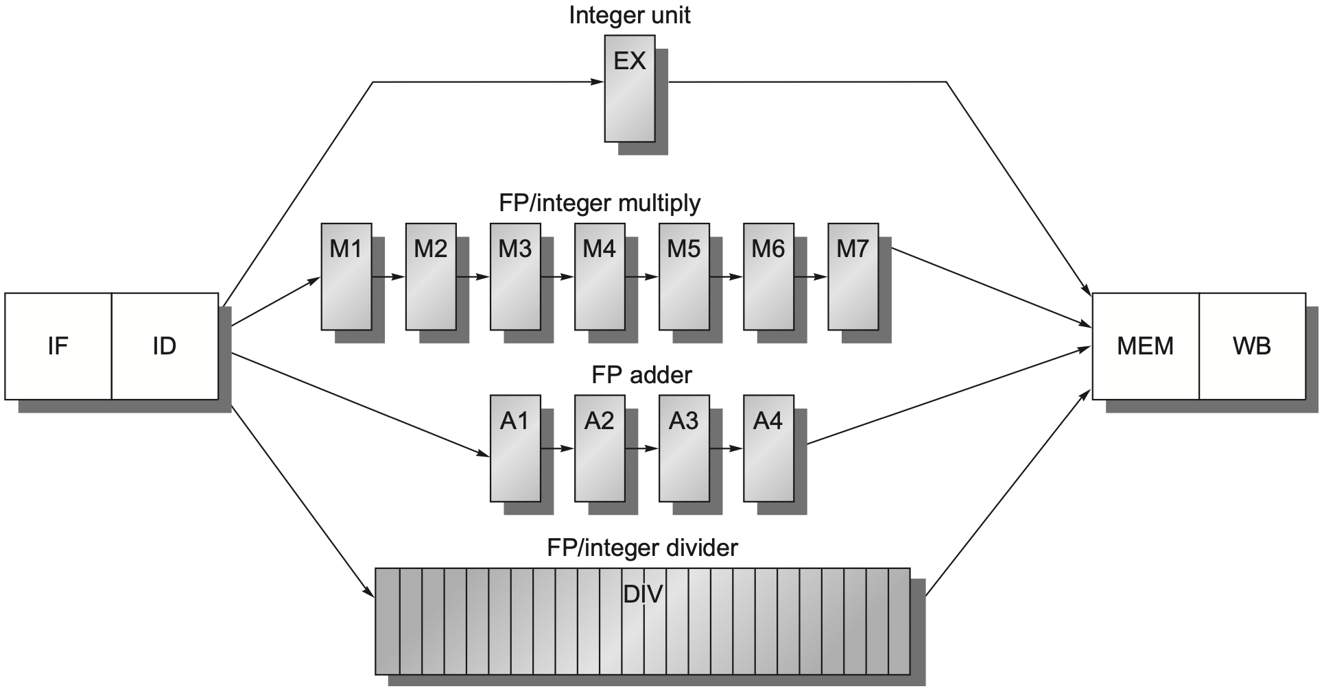
Generalized FP Pipeline
EX is pipelined (except for FP divider)
FP divider is not pipelined
Additional pipeline registers
e.g., ID/A1, M6/M7
FP divider: 24 CCs?

Slide 80
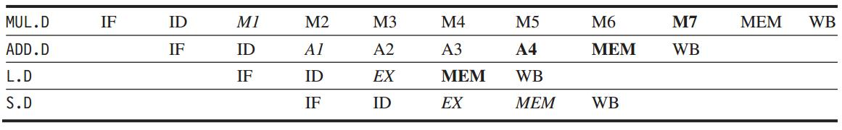
Generalized FP Pipeline
Example: independent FP instr
italics: stage where data is needed
bold: stage where a result is available
compute address
store data
Notes:
The ”.D” extension on the instruction mnemonic indicates double-precision (64-bit) floating-point operations.
EX: compute effective address, using base address register;

Slide 81
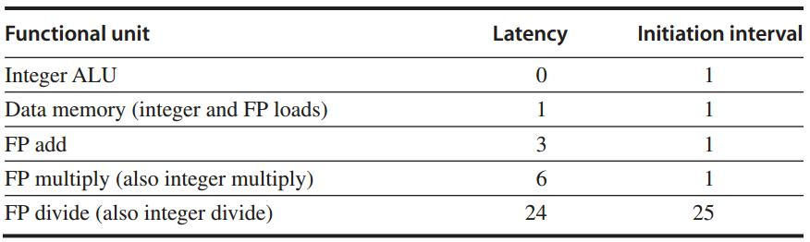
Generalized FP Pipeline
Example: independent FP instr
italics: stage where data is needed
bold: stage where a result is available
Intervening cycles
Notes:
Latency is essentially 1 cycle less than execution depth, so
1 → 0
4 → 3
7 → 6

Slide 82
Any FP pipeline hazards?
Notes:
1. Because the divide unit is not fully pipelined, structural hazards can occur. These will need to be detected and issuing instructions will need to be stalled.
2. Because the instructions have varying running times, the number of register
writes required in a cycle can be larger than 1.
3. Write after write (WAW) hazards are possible, since instructions no longer reach WB in order. Note that write after read (WAR) hazards are not possible, since the register reads always occur in ID.
4. Instructions can complete in a different order than they were issued, causing problems with exceptions; we deal with this in the next subsection.
5. Because of longer latency of operations, stalls for RAW hazards will be more frequent.

Slide 83
Structural Hazard
Divider is not fully pipelined – structural hazard

Slide 84
Structural Hazard
Instructions have varying running times, maybe >1 register write in a cycle
- structural hazard

Slide 85
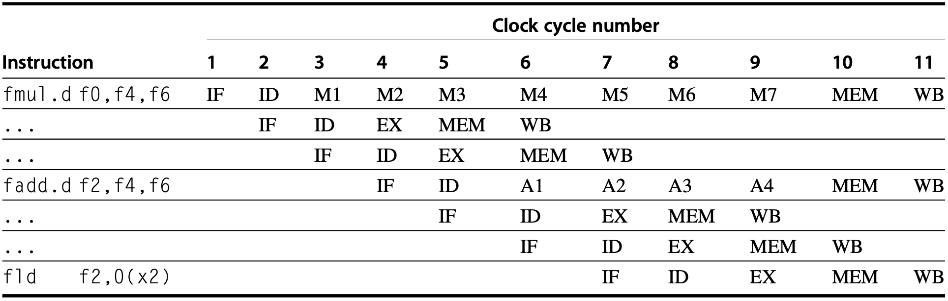
Structural Hazard
Notes:
Cases for competing accesses over memory and register
For MEM:
Note that although the MUL.D, ADD.D and L.D all are in the MEM stage in clock cycle 10,
Only the L.D actually uses the memory, so no structure hazard exists for MEM.

Slide 86
Structural Hazard
Interlock Detection
Method 1: track the use of the write port in the ID stage and stall an instruction before it issues
::a shift register tracks when already-issued instructions will use the register file;
if the instruction in ID needs to use the register file at the same time, stall
Notes:
If the instruction in ID needs to use the register file at the same time as an instruction already issued, the instruction in ID is stalled for a cycle. On each clock the reservation register is shifted 1 bit. This implemen- tation has an advantage: It maintains the property that all interlock detection and stall insertion occurs in the ID stage. The cost is the addition of the shift register and write conflict logic.

Slide 87
Structural Hazard
Interlock Detection
Method 2: stall a conflicting instruction when it tries to enter MEM/WB
::could stall either issuing or issued one;
give priority to the unit with the longest latency; (structural hazard, not data hazard)
more complicated: stall arises from two places - MEM/WB
Notes:
An alternative scheme is to stall a conflicting instruction when it tries to enter either the MEM or WB stage. If we wait to stall the conflicting instructions until they want to enter the MEM or WB stage, we can choose to stall either instruc- tion. A simple, though sometimes suboptimal, heuristic is to give priority to the unit with the longest latency, since that is the one most likely to have caused another instruction to be stalled for a RAW hazard.
The advantage of this scheme is that it does not require us to detect the conflict until the entrance of the MEM or WB stage, where it is easy to see.
The disadvantage is that it complicates pipe- line control, as stalls can now arise from two places.
Notice that stalling before entering MEM will cause the EX, A4, or M7 stage to be occupied, possibly forc- ing the stall to trickle back in the pipeline. Likewise, stalling before WB would cause MEM to back up.

Slide 88
WAW Hazard
Instructions no longer reach WB in order
– Write after write (WAW) hazard

Slide 89
WAW Hazard
If fld were issued one cycle earlier

Slide 90
WAW Hazard
If fld were issued one cycle earlier
fld would write F2 one cycle earlier than fadd.d – WAW hazard
Notes:
If the L.D instruction were issued one cycle earlier and had a destination of F2, then it would create a WAW hazard, because it would write F2 one cycle earlier than the ADD.D.
Note that this hazard only occurs when the result of the ADD.D is overwritten without any instruction ever using it! If there were a use of F2 between the ADD.D and the L.D, the pipeline would need to be stalled for a RAW hazard

Slide 91
WAW Hazard
If fld were issued one cycle earlier
fld would write F2 one cycle earlier than fadd.d – WAW hazard
Solution 1: delay issuing fld
Notes:
The first approach is to delay the issue of the load instruction until the ADD.D enters MEM.

Slide 92
WAW Hazard
If fld were issued one cycle earlier
fld would write F2 one cycle earlier than fadd.d – WAW hazard
Solution 2: zero write control of fadd.d
Notes:
The sec-ond approach is to stamp out the result of the ADD.D by detecting the hazard and changing the control so that the ADD.D does not write its result.

Slide 93
WAW Hazard
If fld were issued one cycle earlier
fld would write F2 one cycle earlier than fadd.d – WAW hazard
Solution 2: zero write control of fadd.d
Make sure that fld decides F2 state
follow program order
Notes:
The goal of both solutions is to make sure that L.D finally decides the state of F2 according to the program logic.

Slide 94
RAW Hazard
Longer latency of operations
– more frequent stalls for
read after write (RAW) hazards

Slide 95
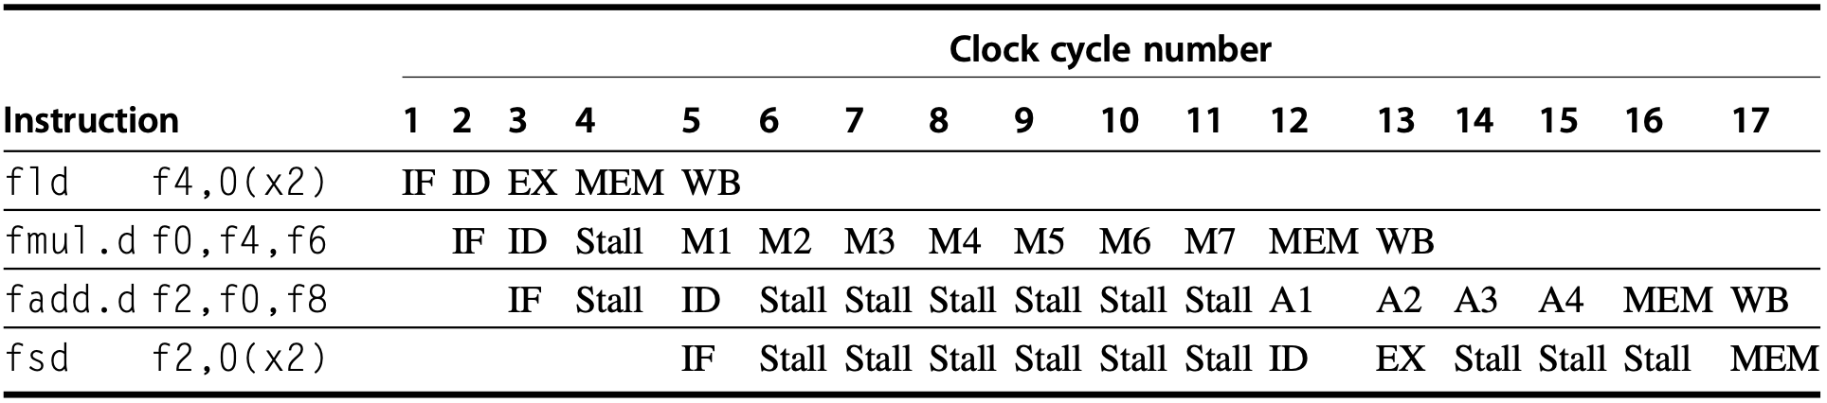
RAW Hazard

Slide 96
RAW Hazard
The fsd must be stalled an extra cycle
so that its MEM does not conflict with the fadd.d

Slide 97

RAW Hazard
The fsd must be stalled an extra cycle
so that its MEM does not conflict with the ADD.D
Only the fld actually uses the memory
So no structure hazard exists for MEM
Notes:
ktnl, i is vegetable

Slide 98
Hazard: Exceptions
Instructions may complete in a different order than they were issued – exceptions
Notes:
Instructions can complete in a different order than they were issued, causing problems with exceptions;

Slide 99
How to detect and solve
pipeline hazards?

Slide 100
Hazard Detection in ID
1. Check for structural hazards
wait until the required functional unit is not busy (only for divides);
make sure the register write port is available when it will be needed;
Notes:
Check for structural hazards—Wait until the required functional unit is not busy (this is only needed for divides in this pipeline) and make sure the regis- ter write port is available when it will be needed.

Slide 101
Hazard Detection in ID
2. Check for RAW data hazards
wait until source registers are available when needed --- when they are not pending destinations of issued instructions
Notes:
Wait until the source registers are not listed as pending destinations in a pipeline register that will not be available when this instruction needs the result. A number of checks must be made here, depending on both the source instruction, which determines when the result will be avail- able, and the destination instruction, which determines when the value is needed.
For example, if the instruction in ID is an FP operation with source reg- ister F2, then F2 cannot be listed as a destination in ID/A1, A1/A2, or A2/A3, which correspond to FP add instructions that will not be finished when the instruction in ID needs a result. (ID/A1 is the portion of the output register of ID that is sent to A1.) Divide is somewhat more tricky, if we want to allow the last few cycles of a divide to be overlapped, since we need to handle the case when a divide is close to finishing as special. In practice, designers might ignore this optimization in favor of a simpler issue test.

Slide 102
Hazard Detection in ID
3. Check for WAW data hazards
determine if any instruction in A1 – A4, D, M1-M7 has the same register destination as this instruction;
if so, stall the issue of the instr in ID
Notes:
Check for a WAW data hazard—Determine if any instruction in A1, . . . , A4, D, M1, . . . , M7 has the same register destination as this instruction. If so, stall the issue of the instruction in ID.

Slide 103
Hazard Detection in ID
3. Check for WAW data hazards
determine if any instruction in A1 – A4, D, M1-M7 has the same register destination as this instruction;
if so, stall the issue of the instr in ID
this is a simplified version;
Notes:
Check for a WAW data hazard—Determine if any instruction in A1, . . . , A4, D, M1, . . . , M7 has the same register destination as this instruction. If so, stall the issue of the instruction in ID.

Slide 104
Hazard Detection in ID
3. Check for WAW data hazards
determine if any instruction in A1 – A4, D, M1-M7 has the same register destination as this instruction;
if so, stall the issue of the instr in ID
this is a simplified version;
more complex: detect instr in ID might finish before an issued instr, knowing pipeline length and its current position
Notes:
Check for a WAW data hazard—Determine if any instruction in A1, . . . , A4, D, M1, . . . , M7 has the same register destination as this instruction. If so, stall the issue of the instruction in ID.
::
The difficult situation is to detect that the L.D might finish before the ADD.D, because that requires knowing the length of the pipeline and the current position of the ADD.D. Luckily, this code sequence (two writes with no intervening read) will be very rare, so we can use a simple solution: If an instruc- tion in ID wants to write the same register as an instruction already issued, do not issue the instruction to EX.

Slide 105
Forwarding
Generalized with more sources
EX/MEM, A4/MEM, M7/MEM, D/MEM, MEM/WB
-> source registers of an FP instruction
Notes:
The forwarding can be implemented by checking if the destination register in any of the EX/MEM, A4/MEM, M7/MEM, D/MEM, or MEM/WB registers is one of the source registers of a floating-point instruction. If so, the appropriate input multiplexer will have to be enabled so as to choose the forwarded data.

Slide 106
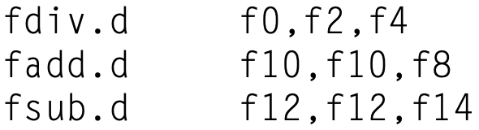
Out-of-Order Completion
ADD and SUB complete before DIV
Out-of-order completion: instructions are completing in a different order than they were issued

Slide 107
Out-of-Order Completion
How to deal with out-of-order?
1. ignore the problem
2. buffer the results of an operation until all the operations issued earlier complete
3. track what operations were in the pipeline and their PCs for trap-handling
4. issue an instruction only if it is certain that all previous instructions will complete without exception
Notes:
The first is to ignore the problem and settle for imprecise exceptions. This approach was used in the 1960s and early 1970s. It is still used in some supercomputers, where certain classes of exceptions are not allowed or are handled by the hardware without stopping the pipeline. It is difficult to use this approach in most processors built today because of features such as virtual memory and the IEEE floating-point standard that essentially require precise exceptions through a combination of hardware and software. As mentioned ear- lier, some recent processors have solved this problem by introducing two modes of execution: a fast, but possibly imprecise mode and a slower, precise mode. The slower precise mode is implemented either with a mode switch or by insertion of explicit instructions that test for FP exceptions. In either case, the amount of overlap and reordering permitted in the FP pipeline is significantly restricted so that effectively only one FP instruction is active at a time. This solution is used in the DEC Alpha 21064 and 21164, in the IBM Power1 and Power2, and in the MIPS R8000.
A second approach is to buffer the results of an operation until all the opera- tions that were issued earlier are complete. Some CPUs actually use this solution, but it becomes expensive when the difference in running times among operations is large, since the number of results to buffer can become large. Furthermore, results from the queue must be bypassed to continue issuing instructions while waiting for the longer instruction. This requires a large number of comparators and a very large multiplexer.
There are two viable variations on this basic approach. The first is a history file, used in the CYBER 180/990. The history file keeps track of the original val- ues of registers. When an exception occurs and the state must be rolled back ear- lier than some instruction that completed out of order, the original value of the register can be restored from the history file. A similar technique is used for auto- increment and autodecrement addressing on processors such as VAXes. Another approach, the future file, proposed by Smith and Pleszkun [1988], keeps the newer value of a register; when all earlier instructions have completed, the main register file is updated from the future file. On an exception, the main register file has the precise values for the interrupted state. In Chapter 3, we saw extensions of this idea which are used in processors such as the PowerPC 620 and the MIPS R10000 to allow overlap and reordering while preserving precise exceptions.
A third technique in use is to allow the exceptions to become somewhat imprecise, but to keep enough information so that the trap-handling routines can create a precise sequence for the exception. This means knowing what operations were in the pipeline and their PCs. Then, after handling the exception, the soft- ware finishes any instructions that precede the latest instruction completed, and the sequence can restart.
The final technique is a hybrid scheme that allows the instruction issue to continue only if it is certain that all the instructions before the issuing instruction will complete without causing an exception. This guarantees that when an excep- tion occurs, no instructions after the interrupting one will be completed and all of the instructions before the interrupting one can be completed. This sometimes means stalling the CPU to maintain precise exceptions. To make this scheme work, the floating-point functional units must determine if an exception is possi- ble early in the EX stage (in the first 3 clock cycles in the MIPS pipeline), so as to prevent further instructions from completing. This scheme is used in the MIPS R2000/3000, the R4000, and the Intel Pentium.

Slide 108
All in MIPS R4000
Notes:
In this section, we look at the pipeline structure and performance of the MIPS R4000 processor family, which includes the 4400. The MIPS architecture and RISC V are very similar, differing only in a few instructions, including a delayed branch in the MIPS ISA. The R4000 implements MIPS64 but uses a deeper pipe- line than that of our five-stage design both for integer and FP programs. This dee- per pipeline allows it to achieve higher clock rates by decomposing the five-stage integer pipeline into eight stages. Because cache access is particularly time critical, the extra pipeline stages come from decomposing the memory access. This type of deeper pipelining is sometimes called superpipelining.

Slide 109
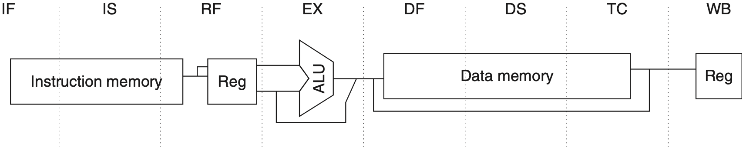
MIPS R4000:
5-stage -> 8-stage
Higher clock rate
Notes:
Since some stage becomes shorter, it requires less time to complete;
So a shorter clock cycle, so higher clock rate…;
This deeper pipeline allows it to achieve higher clock rates by decomposing the five-stage integer pipeline into eight stages.

Slide 110
MIPS R4000:
5-stage -> 8-stage
Higher clock rate
Superpipelining: decompose the memory access because cache access is particularly time critical
Notes:
Because cache access is particularly time critical, the extra pipeline stages come from decomposing the memory access.
This type of deeper pipelining is sometimes called superpipelining.

Slide 111
MIPS R4000:
IF
IF: first half of instruction fetch;
PC selection;
initiation of instruction cache access;

Slide 112
MIPS R4000:
IS
IS: second half of instruction fetch;
completion of instruction cache access;

Slide 113
MIPS R4000:
RF
RF:
instruction decode and register fetch;
hazard checking;
instruction cache hit detection;

Slide 114
MIPS R4000:
EX
EX: execution
effective address calculation;
ALU operation;
branch-target computation and condition evaluation;

Slide 115
MIPS R4000:
DF
DF: data fetch
first half of data access;

Slide 116
MIPS R4000:
DS
DS: second half of data fetch
completion of data cache access;

Slide 117
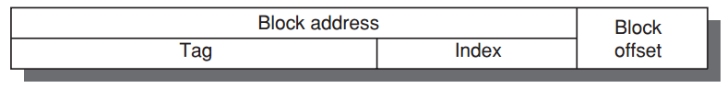
MIPS R4000:
TC
TC: tag check
determine whether the data cache access hit;

Slide 118
MIPS R4000:
WB
WB: write back
for loads and register-register ops;

Slide 119
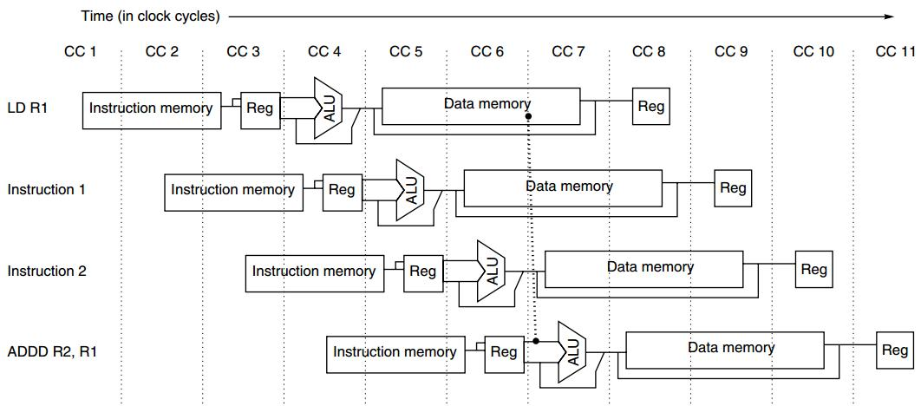
Load Delay
2-cycle load delay
(per the subsequent pipeline diagram)
Notes:
Recall the definition of latency: the number of intervening clock cycles in pipeline between the instruction that produces the result and the instruction that uses the result;
that load delays are 2 cycles, since the data value is available at the end of DS.
(TC for tag checking)

Slide 120
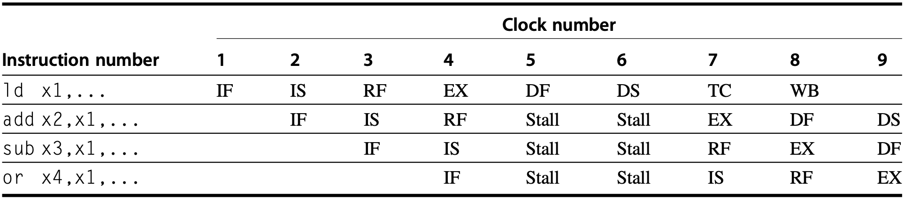
Load Delay
2-cycle load delay
DS: second half of data fetch
completion of data cache access;

Slide 121
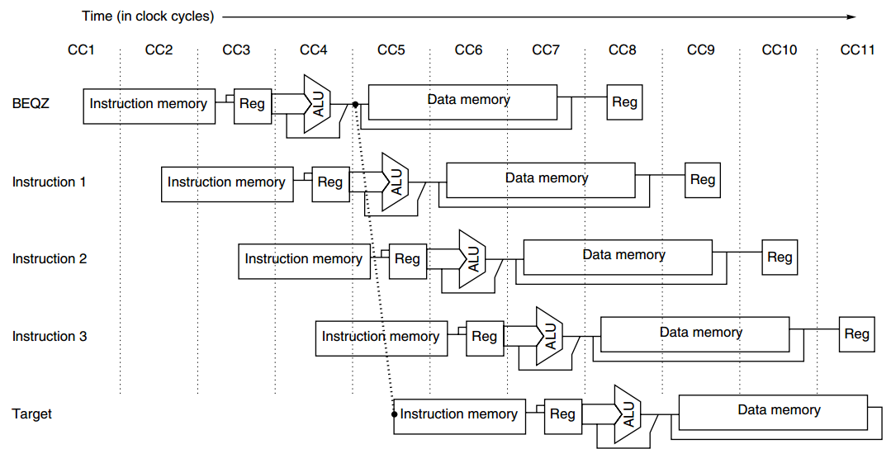
Branch Delay
3-cycle branch delay: condition test- EX
single-cycle delayed branch: instr 1
predicted-not-taken: instr 2, instr 3
Notes:
Branch computes and test branch condition, computes branch target address;
If a branch is taken, then the branch target address is the result used by subsequent instructions;
That is, the target uses the result generated by the branch instruction, 3 intervening clock cycles as shown in the figure;

Slide 122
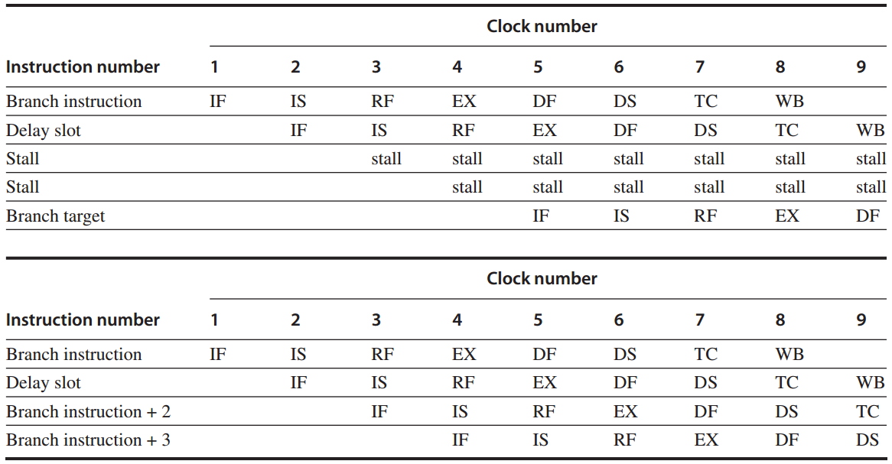
Branch Delay
3-cycle branch delay: for taken
predicted-not-taken
1-cycle branch delay: for untaken
predicted-not-taken
taken branch
EX: branch-target computation & condition evaluation
untaken branch
Notes:
Delay slot: https://en.wikipedia.org/wiki/Delay_slot
In computer architecture, a delay slot is an instruction slot that gets executed without the effects of a preceding instruction. The most common form is a single arbitrary instruction located immediately after a branch instruction on a RISC or DSP architecture; this instruction will execute even if the preceding branch is taken. Thus, by design, the instructions appear to execute in an illogical or incorrect order. It is typical for assemblers to automatically reorder instructions by default, hiding the awkwardness from assembly developers and compilers.
Branch-likely instruction: https://www.microchip.com/forums/m317243.aspx
PIC32 also supports the so called 'branch likely' instructions. For this class of branches the instruction in the branch delay slot is only executed if the branch is taken. In case the branch is NOT taken, the instruction in the branch delay slot is NOT executed (ignored).
Confusion in table 1?
Given predicted-not-taken strategy, why in cc3 and cc4, the 3rd and 4th instructions are stalled (while they should proceed with IF-IS, and IF)?
Discussion: understand the two tables from the perspective that they demonstrate the contrast between the final-effects of whether the branch is taken or not.
This way, the two Stall instructions in table 1 correspond to Branch instruction+2 and Branch instruction+3 in table 2.
Since table 1 represents the case when the branch is taken, after cc4 where branch target is determined, in cc4 branch target will be fetched and previously fetched instructions may be stalled. In other words, the two Stall instructions will not take effect as if they were not procssed at all.

Slide 123
Forwarding
Forwarding
ALU/MEM or MEM/WB
-> EX/DF, DF/DS, DS/TC, TC/WB

Slide 124
FP Operations
FP Pipeline
FP unit with three functional units:
FP divider, FP multiplier, FP adder
2 cycles to 112 cycles
Notes:
The R4000 floating-point unit consists of three functional units: a floating-point divider, a floating-point multiplier, and a floating-point adder. The adder logic is used on the final step of a multiply or divide. Double-precision FP operations can take from 2 cycles (for a negate) up to 112 cycles (for a square root).

Slide 125
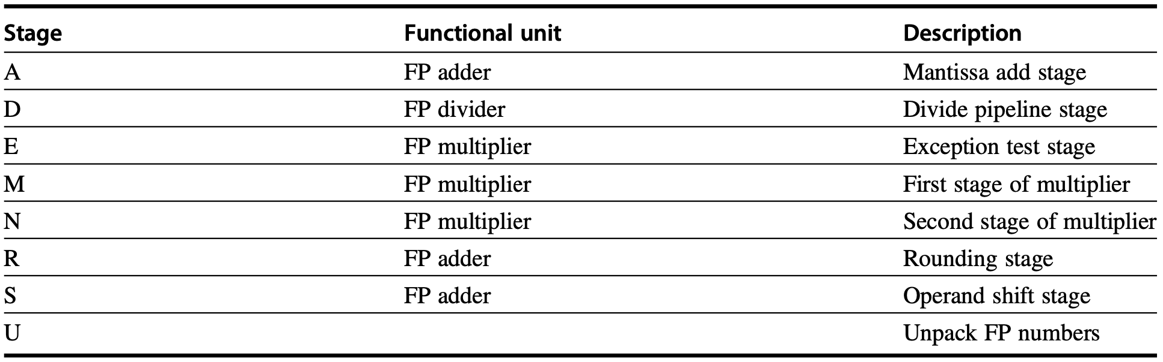
Stage vs FP Unit
FP unit with eight different stages
Notes:
In addition, the various units have different initiation rates. The FP functional unit can be thought of as having eight different stages, listed in Figure C.46; these stages are combined in different orders to execute various FP operations.

Slide 126
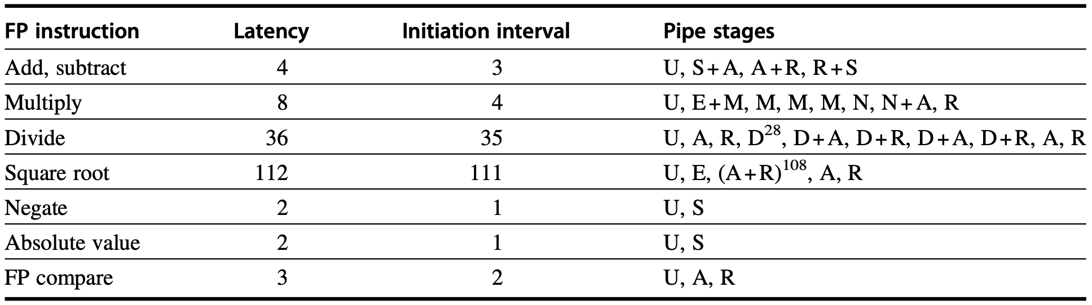
Latency & Ini Interval
FP operations: latency and initiation interval
Notes:
There is a single copy of each of these stages, and various instructions may use a stage zero or more times and in different orders.

Slide 127
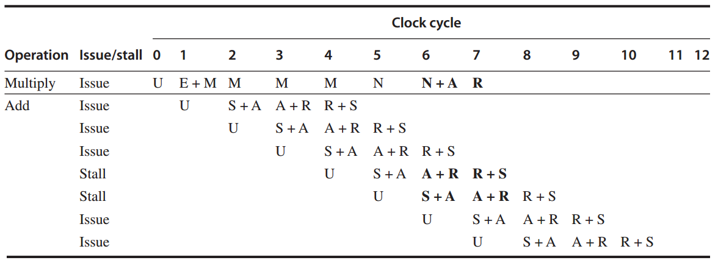
FP Ops: Example 1
FP multiply + FP add
Notes:
Two stalled instructions will use R as the same time when Multiply uses R;

Slide 128
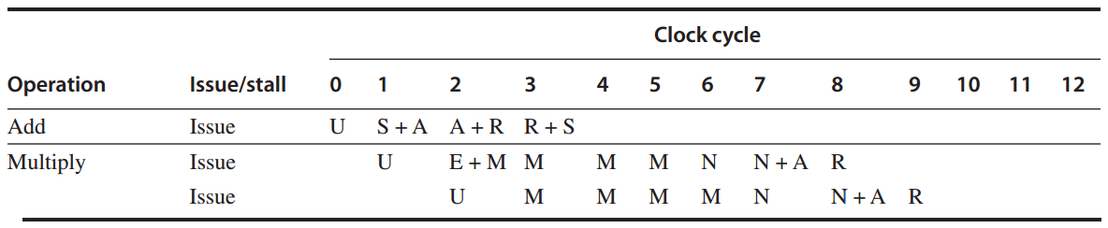
FP Ops: Example 2
FP add + FP multiply

Slide 129
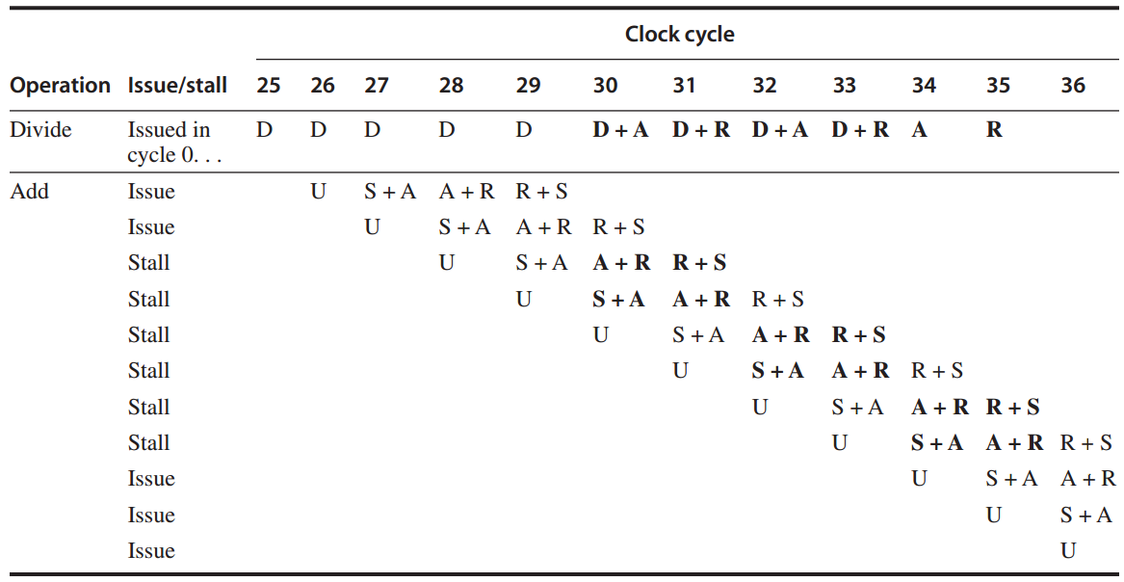
FP Ops: Example 3
divide + add

Slide 130
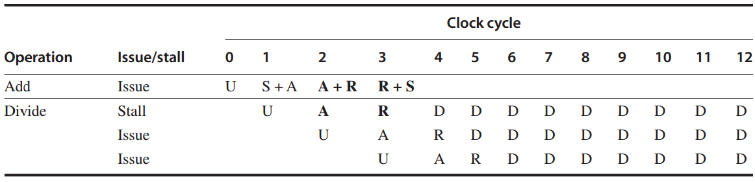
FP Ops: Example 4
FP add + FP divide

Slide 131
How to exploit ILP?

Slide 132
ILP Exploitation
Compiler-based static parallelism only in domain-specific environments or in well-structured scientific applications with significant data-level parallelism
Hardware-based dynamic parallelism
Notes:
There are two largely separable approaches to exploiting ILP: (1) an approach that relies on hardware to help discover and exploit the parallelism dynamically, and (2) an approach that relies on software technology to find parallelism statically at compile time. Processors using the dynamic, hardware-based approach, includ- ing all recent Intel and many ARM processors, dominate in the desktop and server markets. In the personal mobile device market, the same approaches are used in processors found in tablets and high-end cell phones. In the IOT space, where power and cost constraints dominate performance goals, designers exploit lower levels of instruction-level parallelism. Aggressive compiler-based approaches have been attempted numerous times beginning in the 1980s and most recently in the Intel Itanium series, introduced in 1999. Despite enormous efforts, such approaches have been successful only in domain-specific environments or in well-structured scientific applications with significant data-level parallelism.

Slide 133
How much ILP in a program?

Slide 134
Parallel Instructions
Two instructions that can execute simultaneously in a pipeline of arbitrary depth without causing any stalls, assuming sufficient resources and thus no structural hazards
Notes:
If two instructions are parallel, they can execute simultaneously in a pipeline of arbitrary depth without causing any stalls, assuming the pipeline has sufficient resources (and thus no structural hazards exist).

Slide 135
Dependent Instructions
Two instructions that are not parallel
Must be executed in order
May often be partially overlapped
Notes:
If two instructions are dependent, they are not parallel and must be executed in order, although they may often be partially overlapped. The key in both cases is to determine whether an instruction is dependent on another instruction.
Partially overlapped because of pipelining

Slide 136
Dependence
Data dependence
Name dependence
Control dependence
Notes:
There are three different types of dependences: data dependences (also called true data dependences), name dependences, and control dependences.

Slide 137
Data Dependence
An instruction j is data-independent on instruction i if either of the following holds:
Instruction i produces a result that may be used by instruction j;
Instruction j is data-dependent on instruction k, and instruction k is data dependent on i;

Slide 138
Data Dependence
An instruction j is data-independent on instruction i if either of the following holds:
Instruction i produces a result that may be used by instruction j;
Instruction j is data-dependent on instruction k, and instruction k is data dependent on i; (Dependence within a single instr is not considered as a dep: add x1, x1, x1)
Notes:
Note that a depen- dence within a single instruction (such as add x1,x1,x1) is not considered a dependence.

Slide 139
Data Dependence
f0, 0(x1)
f4, f0, f2
f4, 0(x1)
x1, x1, -8
x1, x2, Loop
Example code sequence
Loop:
fld
fadd.d
fsd
addi
bne
Notes:
fadd.d: add double-precision floating-point numbers
For example, consider the following RISC-V code sequence that increments a vector of values in memory (starting at 0(x1) ending with the last element at 0(x2)) by a scalar in register f2.

Slide 140
Data Dependence
f0, 0(x1)
f4, f0, f2
f4, 0(x1)
x1, x1, -8
x1, x2, Loop
Example code sequence
Loop:
Write → Read
fld
fadd.d
fsd
addi
bne
Notes:
fadd.d: add double-precision floating-point numbers
For example, consider the following RISC-V code sequence that increments a vector of values in memory (starting at 0(x1) ending with the last element at 0(x2)) by a scalar in register f2.

Slide 141
Name Dependence
Two instructions use the same register or memory location (name), but there is no flow of data between instructions associated w/ that name
Read → Write or Write → Write

Slide 142
Name Dependence
An instruction i that precedes instr j in program order:
Antidependence: Read → Write
instruction j writes a register or
memory location that instruction i
reads
Output dependence: Write → Write
instruction i and instruction j write
the same register or memory location
Notes:
The second type of dependence is a name dependence. A name dependence occurs when two instructions use the same register or memory location, called a name, but there is no flow of data between the instructions associated with that name. There are two types of name dependences between an instruction i that precedes instruc- tion j in program order:
1. An antidependence between instruction i and instruction j occurs when instruc- tion j writes a register or memory location that instruction i reads. The original ordering must be preserved to ensure that i reads the correct value. In the example
on page 171, there is an antidependence between fsd and addi on register x1.
2. Anoutputdependenceoccurswheninstructioniandinstructionjwritethesame register or memory location. The ordering between the instructions must be preserved to ensure that the value finally written corresponds to instruction j.

Slide 143
Name Dependence
f0, 0(x1)
f0, f1, f2
f4, 0(x1)
x1, x1, -8
x1, x2, Loop
Example code sequence
Loop:
x1: Read → Write, antidependence
fld
fadd.d
fsd
addi
bne

Slide 144
Name Dependence
f0, 0(x1)
f0, f1, f2
f4, 0(x1)
x1, x1, -8
x1, x2, Loop
Example code sequence
Loop:
x1: Read → Write, antidependence
f0: Write → Write, output dependence
fld
fadd.d
fsd
addi
bne

Slide 145
Name Dependence
Register Renaming: change the name (register number or memory location) used in name-dependent instructions such that the instructions do not conflict
Statically by compiler or dynamically by hardware
Renamed instructions can execute simultaneously or be reordered
Notes:
more in subsequent lectures

Slide 146
Data Hazard
Hazard exists whenever
1) there is a name/data dependence between instructions;
2) they are close enough; AND
3) the overlap during execution would change the order of access to the operand involved in the dependence
Notes:
A hazard exists whenever there is a name or data dependence between instructions, and they are close enough that the overlap during execution would change the order of access to the operand involved in the dependence. Because of the depen- dence, we must preserve what is called program order—that is, the order that the instructions would execute in if executed sequentially one at a time as determined by the original source program. The goal of both our software and hardware tech- niques is to exploit parallelism by preserving program order only where it affects the outcome of the program. Detecting and avoiding hazards ensures that neces- sary program order is preserved.

Slide 147
Data Hazard
Read After Write (RAW) j reads a source before i writes it, j incorrectly gets the old value
Write After Write (WAW) j writes a destination before i writes it, leaving the value written by i but not j
Write After Read (WAR) j writes a destination before i reads it, i incorrectly gets the new value
Notes:
Reader After Write is what it should be enforced by program order, then the associated data hazard is when instruction execution violates this order → read before write / write after read (for example)

Slide 148
Control Dependence
Example code sequence
if p1 {
};
if p2 {
};
S1;
S2;

Slide 149
Control Dependence
Example code sequence
if p1 {
};
if p2 {
};
S1 is control-dependent on p1
S2 is control-dependent on p2
S1;
S2;

Slide 150
Pipelining Performance
Ideal Pipeline CPI
Pipeline CPI
Data Hazard Stalls
Control Stalls
Structural Stalls
Notes:
The value of the CPI (cycles per instruction) for a pipelined processor is the sum of the base CPI and all contributions from stalls:
Pipeline CPI 1⁄4 Ideal pipeline CPI + Structural stalls + Data hazard stalls + Control stalls
The ideal pipeline CPI is a measure of the maximum performance attainable by the implementation. By reducing each of the terms of the right-hand side, we decrease the overall pipeline CPI or, alternatively, increase the IPC (instructions per clock). The preceding equation allows us to characterize various techniques by what com- ponent of the overall CPI a technique reduces. Figure 3.1 shows the techniques we examine in this chapter and in Appendix H, as well as the topics covered in the introductory material in Appendix C. In this chapter, we will see that the tech- niques we introduce to decrease the ideal pipeline CPI can increase the importance of dealing with hazards.

Slide 151
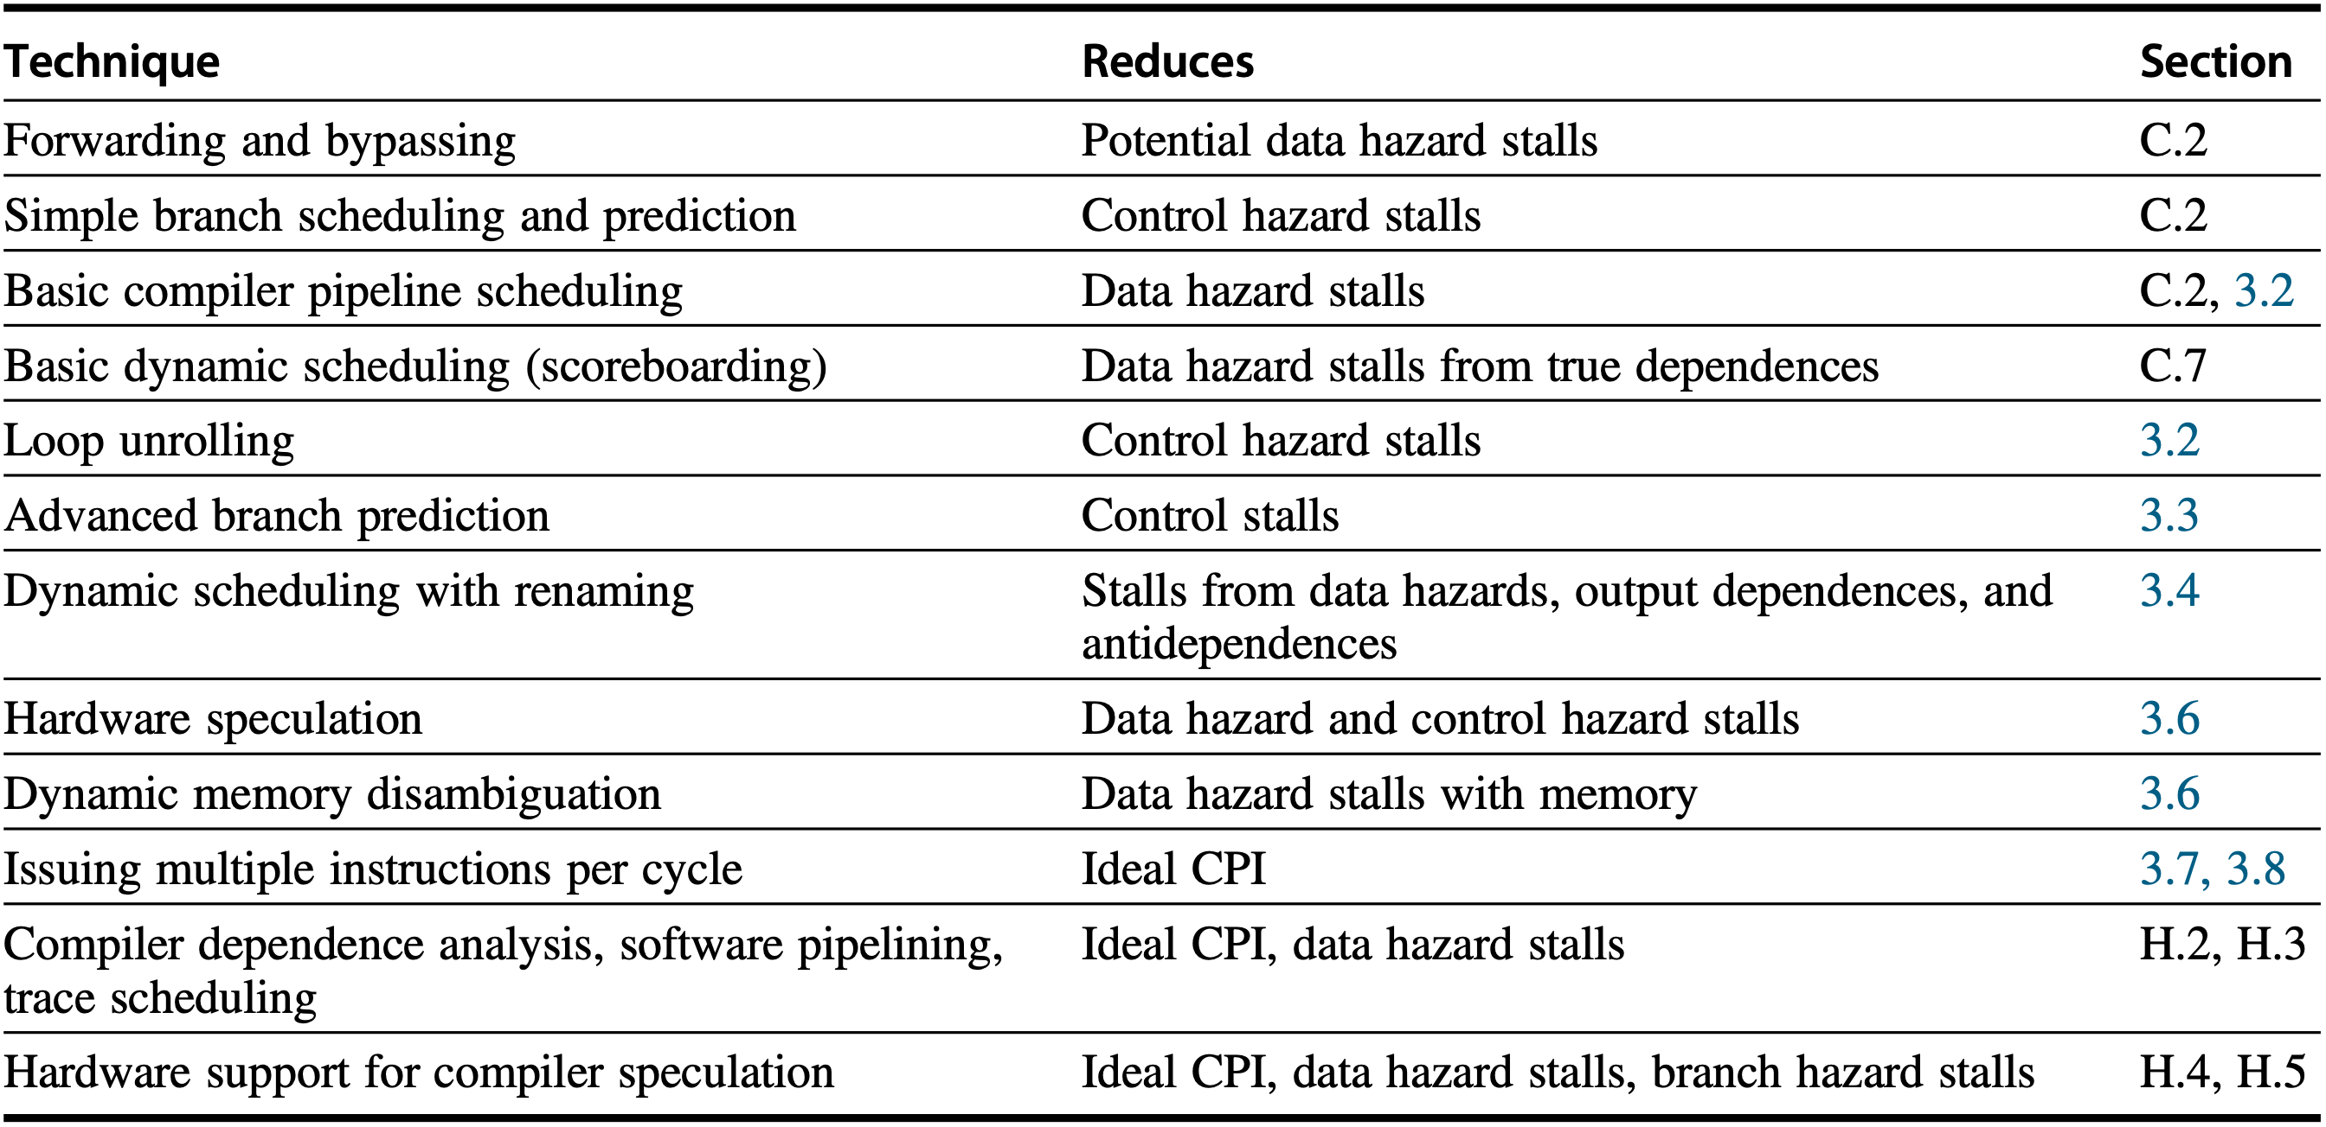
Pipelining Optimization
Notes:
Figure 3.1 The major techniques examined in Appendix C, Chapter 3, and Appendix H are shown together with the component of the CPI equation that the technique affects.

Slide 152
Property Constraints
Exception Behavior
any changes in the ordering of instruction execution must not change how exceptions are raised in the program
Data Flow
the actual flow of data values among instructions that produce results and those that consume them
Notes:
While optimizing pipelining performance, the two properties critical to program correctness—and normally preserved by maintaining both data and control dependences—are the exception behavior and the data flow.
Preserving the exception behavior means that any changes in the ordering of instruction execution must not change how exceptions are raised in the program.
The data flow is the actual flow of data values among instructions that produce results and those that consume them.

Slide 153
Exception Behavior
Exception Behavior
any changes in the ordering of instruction execution must not change how exceptions are raised in the program;
often relaxed to: reordering of instruction execution must not cause any new exceptions in the program
Notes:
Preserving the exception behavior means that any changes in the ordering of instruction execution must not change how exceptions are raised in the program.
Often this is relaxed to mean that the reordering of instruction execution must not cause any new exceptions in the program.

Slide 154
Exception Behavior
x2, x3, x4
x2, x0, L1
x1, 0(x2)
Example code sequence
L1:
add
beq
ld
…
Notes:
A simple example shows how maintain- ing the control and data dependences can prevent such situations. Consider this code sequence:

Slide 155
Exception Behavior
x2, x3, x4
x2, x0, L1
x1, 0(x2)
Example code sequence
L1:
x2: data dependence
add
beq
ld
…

Slide 156
Exception Behavior
x2, x3, x4
x2, x0, L1
x1, 0(x2)
Example code sequence
L1:
x2: add → beq, data dependence
x2: beq → ld, control dependence for memory protection
add
beq
ld
…
Notes:
In this case, it is easy to see that if we do not maintain the data dependence involving x2, we can change the result of the program. Less obvious is the fact that if we ignore the control dependence and move the load instruction before the branch, the load instruction may cause a memory protection exception. Notice that no data dependence prevents us from interchanging the beqz and the ld; it is only the control dependence.

Slide 157
Data Flow
Data Flow
the actual flow of data values among instructions that produce results and those that consume them;
branches make data flow dynamic as they allow the source of data for a given instruction to come from many points
Notes:
The data flow is the actual flow of data values among instructions that produce results and those that consume them.

Slide 158
Data Flow
x1, x2, x3
x4, x0, L
x1, x5, x6
x7, x1, x8
Example code sequence
L:
add
beq
sub
…
or

Slide 159
Data Flow
x1, x2, x3
x4, x0, L
x1, x5, x6
x7, x1, x8
Example code sequence
L:
x1 of or instruction is data-dependent on both add and sub instructions
value of x1 is control-dependent on beq
add
beq
sub
…
or
Notes:
In this example, the value of x1 used by the or instruction depends on whether the branch is taken or not. Data dependence alone is not sufficient to preserve correct- ness. The or instruction is data-dependent on both the add and sub instructions, but preserving that order alone is insufficient for correct execution.
Instead, when the instructions execute, the data flow must be preserved: If the branch is not taken, then the value of x1 computed by the sub should be used by the or, and if the branch is taken, the value of x1 computed by the add should be used by the or. By preserving the control dependence of the or on the branch, we prevent an illegal change to the data flow. For similar reasons, the sub instruc- tion cannot be moved above the branch. Speculation, which helps with the exception problem, will also allow us to lessen the impact of the control dependence while still maintaining the data flow, as we will see in Section 3.6.

Slide 160
How to exploit ILP?

Slide 161
ILP Exploitation
Compiler-based static parallelism only in domain-specific environments or in well-structured scientific applications with significant data-level parallelism
Hardware-based dynamic parallelism
Notes:
There are two largely separable approaches to exploiting ILP: (1) an approach that relies on hardware to help discover and exploit the parallelism dynamically, and (2) an approach that relies on software technology to find parallelism statically at compile time. Processors using the dynamic, hardware-based approach, includ- ing all recent Intel and many ARM processors, dominate in the desktop and server markets. In the personal mobile device market, the same approaches are used in processors found in tablets and high-end cell phones. In the IOT space, where power and cost constraints dominate performance goals, designers exploit lower levels of instruction-level parallelism. Aggressive compiler-based approaches have been attempted numerous times beginning in the 1980s and most recently in the Intel Itanium series, introduced in 1999. Despite enormous efforts, such approaches have been successful only in domain-specific environments or in well-structured scientific applications with significant data-level parallelism.

Slide 162
Static Scheduling
Pipeline Scheduling
re-order instructions to avoid stalls
Loop Unrolling
replicate the loop body multiple times to increase the number of instructions relative to the branch and overhead instructions

Slide 163
Pipeline Scheduling
Example code segment
for (i = 999; i >= 0; i = i - 1)
x[i] = x[i] + s;
RISC-V code
Loop:
f0, 0(x1)
f4, f0, f2
f4, 0(x1)
x1, x1, -8
x1, x2, Loop
fld
fadd.d
fsd
addi
bne
Notes:
In this section, we look at how the compiler can increase the amount of avail- able ILP by transforming loops. This example serves both to illustrate an important technique as well as to motivate the more powerful program transformations described in Appendix H. We will rely on the following code segment, which adds a scalar to a vector:
for (i=999; i>=0; i=i"1) x[i] = x[i] + s;
The first step is to translate the preceding segment to RISC-V assembly language. In the following code segment, x1 is initially the address of the element in the array with the highest address, and f2 contains the scalar value s. Register x2 is precom- puted so that Regs[x2]+8 is the address of the last element to operate on.

Slide 164
Pipeline Scheduling
Example code segment
for (i = 999; i >= 0; i = i - 1)
x[i] = x[i] + s;
RISC-V code
Loop:
f0, 0(x1)
f4, f0, f2
f4, 0(x1)
x1, x1, -8
x1, x2, Loop
fld
fadd.d
fsd
addi
bne
highest-address element
of x[i]

Slide 165
Pipeline Scheduling
Example code segment
for (i = 999; i >= 0; i = i - 1)
x[i] = x[i] + s;
RISC-V code
Loop:
f0, 0(x1)
f4, f0, f2
f4, 0(x1)
x1, x1, -8
x1, x2, Loop
fld
fadd.d
fsd
addi
bne
highest-address element
of x[i]
scalar value s

Slide 166
Pipeline Scheduling
Example code segment
for (i = 999; i >= 0; i = i - 1)
x[i] = x[i] + s;
RISC-V code
Loop:
f0, 0(x1)
f4, f0, f2
f4, 0(x1)
x1, x1, -8
x1, x2, Loop
fld
fadd.d
fsd
addi
bne
highest-address element
of x[i]
scalar value s
decrement pointer per double word

Slide 167
Pipeline Scheduling
Example code segment
for (i = 999; i >= 0; i = i - 1)
x[i] = x[i] + s;
RISC-V code
Loop:
f0, 0(x1)
f4, f0, f2
f4, 0(x1)
x1, x1, -8
x1, x2, Loop
fld
fadd.d
fsd
addi
bne
highest-address element
of x[i]
scalar value s
move to next element

Slide 168
Pipeline Scheduling
Example code segment
for (i = 999; i >= 0; i = i - 1)
x[i] = x[i] + s;
RISC-V code
Loop:
f0, 0(x1)
f4, f0, f2
f4, 0(x1)
x1, x1, -8
x1, x2, Loop
fld
fadd.d
fsd
addi
bne
highest-address element
of x[i]
scalar value s
move to next element
Regs[x2]+8 for lowest-address element

Slide 169
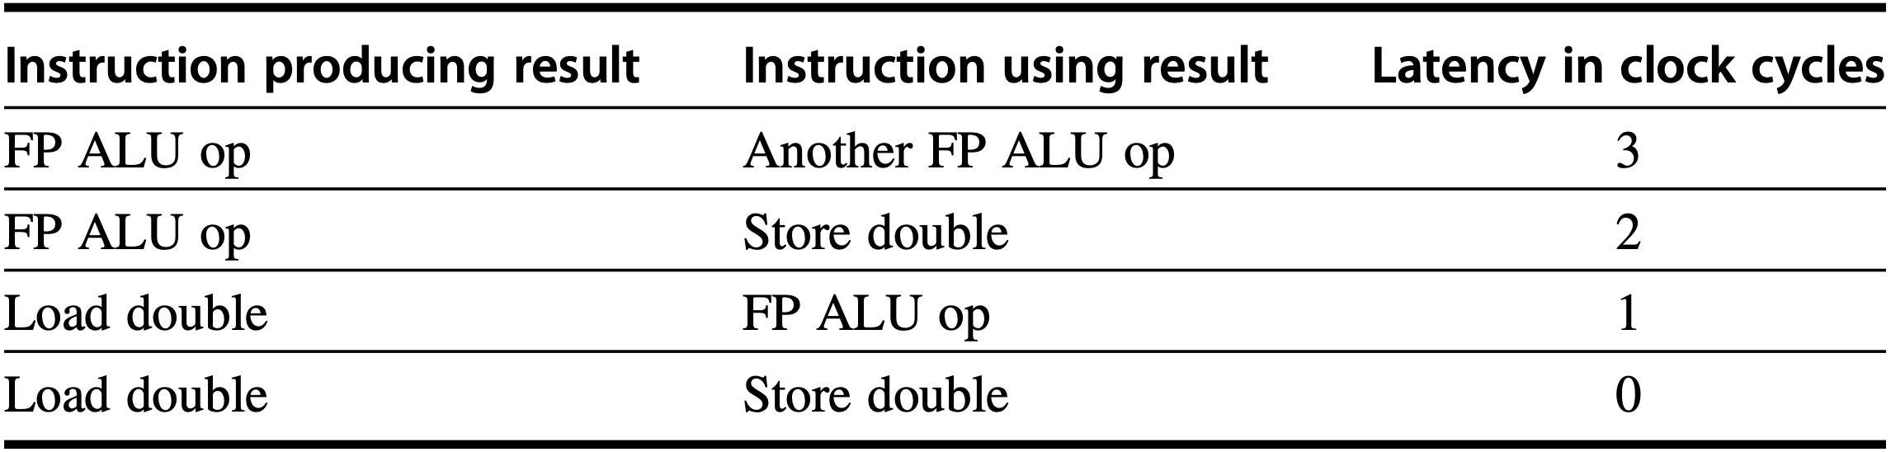
Pipeline Scheduling
RISC-V code
Loop:
How many clock cycles per loop?
f0, 0(x1)
f4, f0, f2
f4, 0(x1)
x1, x1, -8
x1, x2, Loop
fld
fadd.d
fsd
addi
bne
Notes:
Figure 3.2 Latencies of FP operations used in this chapter. The last column is the number of intervening clock cycles needed to avoid a stall. These numbers are similar to the average latencies we would see on an FP unit. The latency of a floating-point load to a store is 0 because the result of the load can be bypassed without stalling the store. We will continue to assume an integer load latency of 1 and an integer ALU operation latency of 0 (which includes ALU operation to branch).

Slide 170
Pipeline Scheduling
RISC-V code
Loop:
How many clock cycles per loop?
f0, 0(x1)
f4, f0, f2
f4, 0(x1)
x1, x1, -8
x1, x2, Loop
fld
fadd.d
fsd
addi
bne
1-CC stall

Slide 171
Pipeline Scheduling
RISC-V code
Loop:
How many clock cycles per loop?
f0, 0(x1)
f4, f0, f2
f4, 0(x1)
x1, x1, -8
x1, x2, Loop
fld
fadd.d
fsd
addi
bne
1-CC stall
2-CC stall

Slide 172
Pipeline Scheduling
RISC-V code
Loop:
How many clock cycles per loop?: 8
f0, 0(x1)
f4, f0, f2
f4, 0(x1)
x1, x1, -8
x1, x2, Loop
fld
fadd.d
fsd
addi
bne
1-CC stall
2-CC stall
Notes:
5 instructions ideally take 5 clock cycles on pipeline, plus three stall cycles

Slide 173
Pipeline Scheduling
RISC-V code
Loop:
How many clock cycles per loop?: 7
f0, 0(x1)
x1, x1, -8
f4, f0, f2
f4, 8(x1)
x1, x2, Loop
fld
addi
fadd.d
fsd
bne
2-CC stall
Notes:
move addi after fld
i.e., postpone fadd.d that depends on fld in terms of f0 one clock cycle

Slide 174
Pipeline Scheduling
RISC-V code
Loop:
How many clock cycles per loop?: 7
3/7 is actual work
f0, 0(x1)
x1, x1, -8
f4, f0, f2
f4, 8(x1)
x1, x2, Loop
fld
addi
fadd.d
fsd
bne
2-CC stall
Notes:
In the previous example, we complete one loop iteration and store back one array element every seven clock cycles, but the actual work of operating on the array element takes just three (the load, add, and store) of those seven clock cycles.
The remaining four clock cycles consist of loop overhead—the addi and bne— and two stalls. To eliminate these four clock cycles, we need to get more operations relative to the number of overhead instructions.

Slide 175
Pipeline Scheduling
RISC-V code
Loop:
How many clock cycles per loop?: 7
3/7 is actual work
f0, 0(x1)
x1, x1, -8
f4, f0, f2
f4, 8(x1)
x1, x2, Loop
fld
addi
fadd.d
fsd
bne
How to loop overhead?
2-CC stall
Notes:
In the previous example, we complete one loop iteration and store back one array element every seven clock cycles, but the actual work of operating on the array element takes just three (the load, add, and store) of those seven clock cycles.
The remaining four clock cycles consist of loop overhead—the addi and bne— and two stalls. To eliminate these four clock cycles, we need to get more operations relative to the number of overhead instructions.

Slide 176
How to loop overhead?

Slide 177
Loop Unrolling
RISC-V code
Loop:
Replicate loop body multiple times given the same amount of overhead instructions
f0, 0(x1)
x1, x1, -8
f4, f0, f2
f4, 8(x1)
x1, x2, Loop
fld
addi
fadd.d
fsd
bne
2-CC stall
Notes:
In the previous example, we complete one loop iteration and store back one array element every seven clock cycles, but the actual work of operating on the array element takes just three (the load, add, and store) of those seven clock cycles.
The remaining four clock cycles consist of loop overhead—the addi and bne— and two stalls. To eliminate these four clock cycles, we need to get more operations relative to the number of overhead instructions.

Slide 178
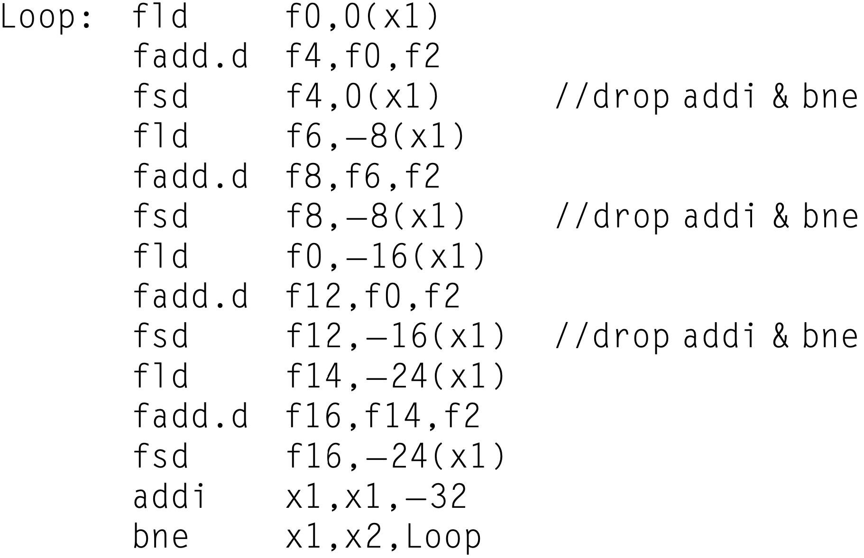
Loop Unrolling
RISC-V code
Notes:
how our loop unrolled so that there are four copies of the loop body, assuming x1 " x2 (that is, the size of the array) is initially a multiple of 32, which means that the number of loop iterations is a multiple of 4. Eliminate any obviously redundant computations and do not reuse any of the registers.
Here is the result after merging the addi instructions and dropping the unnec- essary bne operations that are duplicated during unrolling. Note that x2 must now be set so that Regs[x2]+32 is the starting address of the last four elements.
We have eliminated three branches and three decrements of x1. The addresses on the loads and stores have been compensated to allow the addi instructions on x1 to be merged.

Slide 179
Loop Unrolling
RISC-V code
highest-address element
of x[i]
Regs[x2]+32
for lowest-address element
Notes:
how our loop unrolled so that there are four copies of the loop body, assuming x1 " x2 (that is, the size of the array) is initially a multiple of 32, which means that the number of loop iterations is a multiple of 4. Eliminate any obviously redundant computations and do not reuse any of the registers.
Here is the result after merging the addi instructions and dropping the unnec- essary bne operations that are duplicated during unrolling. Note that x2 must now be set so that Regs[x2]+32 is the starting address of the last four elements.
We have eliminated three branches and three decrements of x1. The addresses on the loads and stores have been compensated to allow the addi instructions on x1 to be merged.

Slide 180
Loop Unrolling
RISC-V code: 26-CC per four ops
highest-address element
of x[i]
Regs[x2]+32
for lowest-address element
Notes:
Without scheduling, every FP load or operation in the unrolled loop is followed by a dependent operation and thus will cause a stall. This unrolled loop will run in 26 clock cycles—each fld has 1 stall, each fadd.d has 2, plus 14 instruction issue cycles—or 6.5 clock cycles for each of the four elements, but it can be sched- uled to improve performance significantly. Loop unrolling is normally done early in the compilation process so that redundant computations can be exposed and eliminated by the optimizer.
how our loop unrolled so that there are four copies of the loop body, assuming x1 " x2 (that is, the size of the array) is initially a multiple of 32, which means that the number of loop iterations is a multiple of 4. Eliminate any obviously redundant computations and do not reuse any of the registers.
Here is the result after merging the addi instructions and dropping the unnec- essary bne operations that are duplicated during unrolling. Note that x2 must now be set so that Regs[x2]+32 is the starting address of the last four elements.
We have eliminated three branches and three decrements of x1. The addresses on the loads and stores have been compensated to allow the addi instructions on x1 to be merged.

Slide 181
Loop Unrolling
RISC-V code: 6.5-CC per op
highest-address element
of x[i]
Regs[x2]+32
for lowest-address element
Notes:
Without scheduling, every FP load or operation in the unrolled loop is followed by a dependent operation and thus will cause a stall. This unrolled loop will run in 26 clock cycles—each fld has 1 stall, each fadd.d has 2, plus 14 instruction issue cycles—or 6.5 clock cycles for each of the four elements, but it can be sched- uled to improve performance significantly. Loop unrolling is normally done early in the compilation process so that redundant computations can be exposed and eliminated by the optimizer.

Slide 182
How to gain more?

Slide 183
Scheduling!
re-order coverage
original: 6 instructions
unrolled: 14 instructions

Slide 184
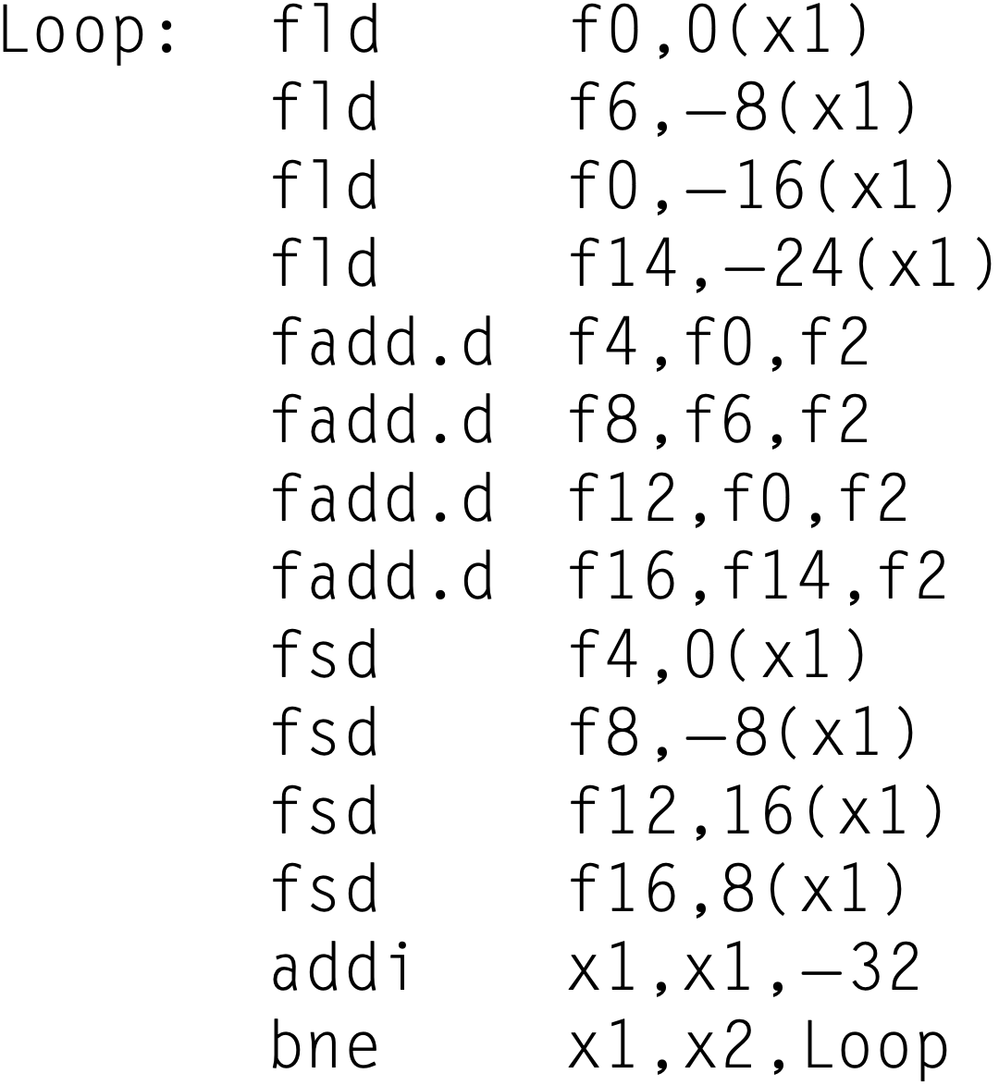
Loop Unrolling & Scheduling
RISC-V code: 14-CC per four ops
highest-address element
of x[i]
Regs[x2]+32
for lowest-address element
Notes:
The execution time of the unrolled loop has dropped to a total of 14 clock cycles, or 3.5 clock cycles per element, compared with 8 cycles per element before any unrolling or scheduling and 6.5 cycles when unrolled but not scheduled.

Slide 185
Loop Unrolling & Scheduling
RISC-V code: 3.5-CC per op
highest-address element
of x[i]
Regs[x2]+32
for lowest-address element
Notes:
The execution time of the unrolled loop has dropped to a total of 14 clock cycles, or 3.5 clock cycles per element, compared with 8 cycles per element before any unrolling or scheduling and 6.5 cycles when unrolled but not scheduled.
The gain from scheduling on the unrolled loop is even larger than on the original loop. This increase arises because unrolling the loop exposes more computation that can be scheduled to minimize the stalls; the preceding code has no stalls. Scheduling the loop in this fashion necessitates realizing that the loads and stores are independent and can be interchanged.
The scheduler in this example essentially interleaves instructions from different loop iterations, so as to separate the dependent instructions that occur within a single loop iteration. By choosing instructions from different iterations, dependent computations are separated from one another by an entire loop body, increasing the possibility that the unrolled loop can be scheduled without stalls.

Slide 186
How to handle branches?

Slide 187
How to handle branches?
often you don’t have to

Slide 188
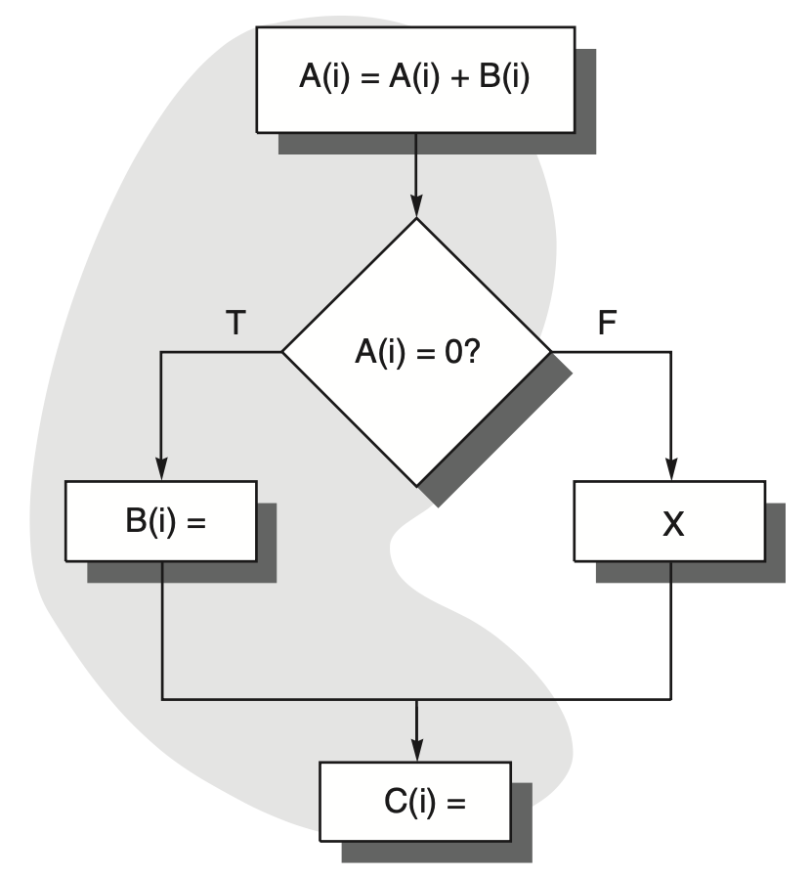
Frequent Critical Path
99%
1%

Slide 189
Frequent Critical Path
Focus on a frequent critical path as if the branch were gone
99%
1%

Slide 190
Trace Scheduling
Trace: a likely sequence of basic blocks whose operations will be put together into a smaller number of instructions
Trace Selection: find the frequent path
Trace Compaction: compress on-path instructions into fewer wider instructions
99%
1%

Slide 191
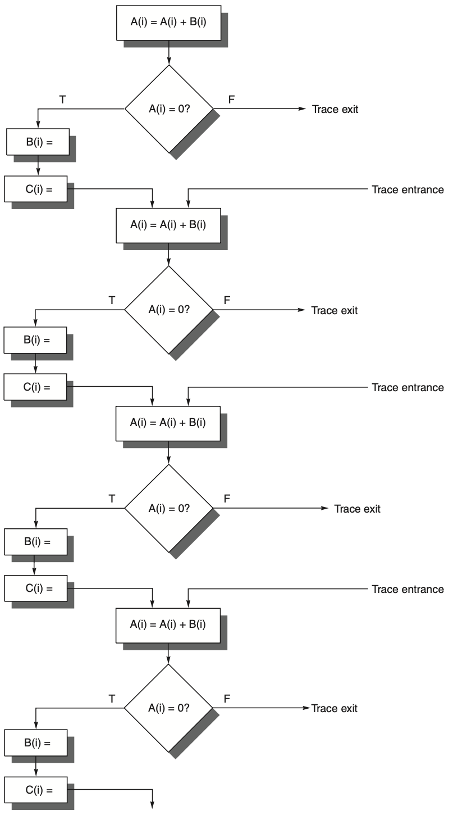
Trace Scheduling
unrolled trace
trace exit where control flow jumps off the frequent path
trace entrance where control flow returns to the trace
Notes:
Figure H.4 This trace is obtained by assuming that the program fragment in Figure H.3 is the inner loop and unwinding it four times, treating the shaded portion in Figure H.3 as the likely path. The trace exits correspond to jumps off the frequent path, and the trace entrances correspond to returns to the trace.

Slide 192
Trace Scheduling
too many entrances and exits amidst the trace
Notes:
Figure H.4 This trace is obtained by assuming that the program fragment in Figure H.3 is the inner loop and unwinding it four times, treating the shaded portion in Figure H.3 as the likely path. The trace exits correspond to jumps off the frequent path, and the trace entrances correspond to returns to the trace.

Slide 193
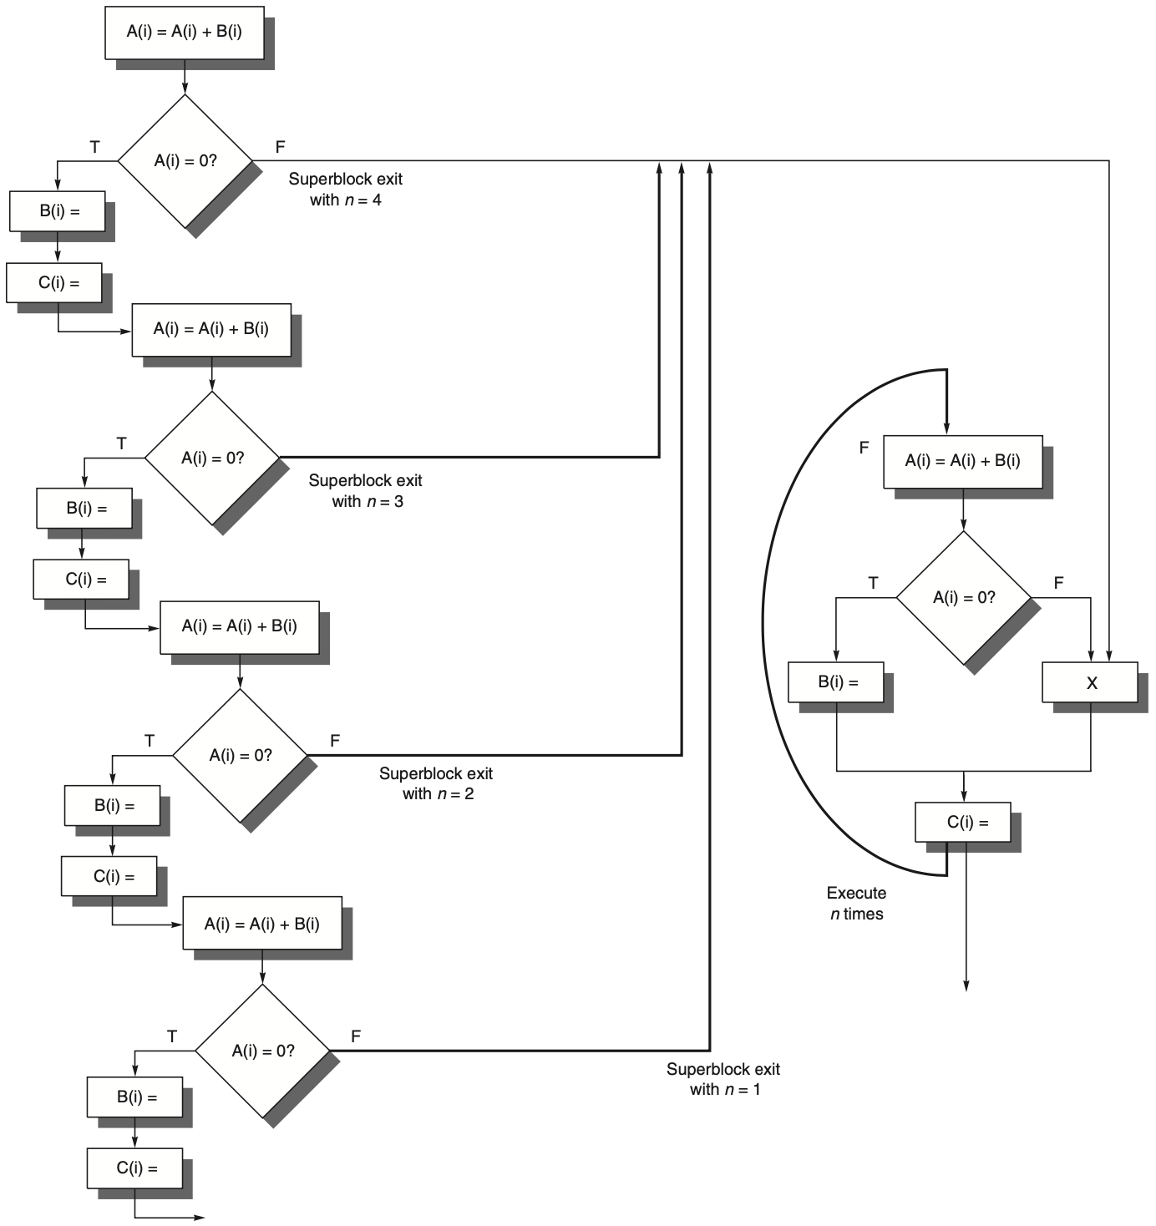
Superblock
single entrance & multiple exits
Notes:
Figure H.5 This superblock results from unrolling the code in Figure H.3 four times and creating a superblock.
One of the major drawbacks of trace scheduling is that the entries and exits into the middle of the trace cause significant complications, requiring the compiler to gen- erate and track the compensation code and often making it difficult to assess the cost of such code. Superblocks are formed by a process similar to that used for traces, but are a form of extended basic blocks, which are restricted to a single entry point but allow multiple exits.
How can a superblock with only one entrance be constructed? The answer is to use tail duplication to create a separate block that corresponds to the portion of the trace after the entry. In our previous example, each unrolling of the loop would create an exit from the superblock to a residual loop that handles the remaining iterations. Figure H.5 shows the superblock structure if the code fragment from Figure H.3 is treated as the body of an inner loop and unrolled four times. The residual loop handles any iterations that occur if the superblock is exited, which, in turn, occurs when the unpredicted path is selected. If the expected frequency of the residual loop were still high, a superblock could be created for that loop as well.

Slide 194
Superblock
single entrance & multiple exits
Notes:
Figure H.5 This superblock results from unrolling the code in Figure H.3 four times and creating a superblock.
One of the major drawbacks of trace scheduling is that the entries and exits into the middle of the trace cause significant complications, requiring the compiler to gen- erate and track the compensation code and often making it difficult to assess the cost of such code. Superblocks are formed by a process similar to that used for traces, but are a form of extended basic blocks, which are restricted to a single entry point but allow multiple exits.
How can a superblock with only one entrance be constructed? The answer is to use tail duplication to create a separate block that corresponds to the portion of the trace after the entry. In our previous example, each unrolling of the loop would create an exit from the superblock to a residual loop that handles the remaining iterations. Figure H.5 shows the superblock structure if the code fragment from Figure H.3 is treated as the body of an inner loop and unrolled four times. The residual loop handles any iterations that occur if the superblock is exited, which, in turn, occurs when the unpredicted path is selected. If the expected frequency of the residual loop were still high, a superblock could be created for that loop as well.

Slide 195
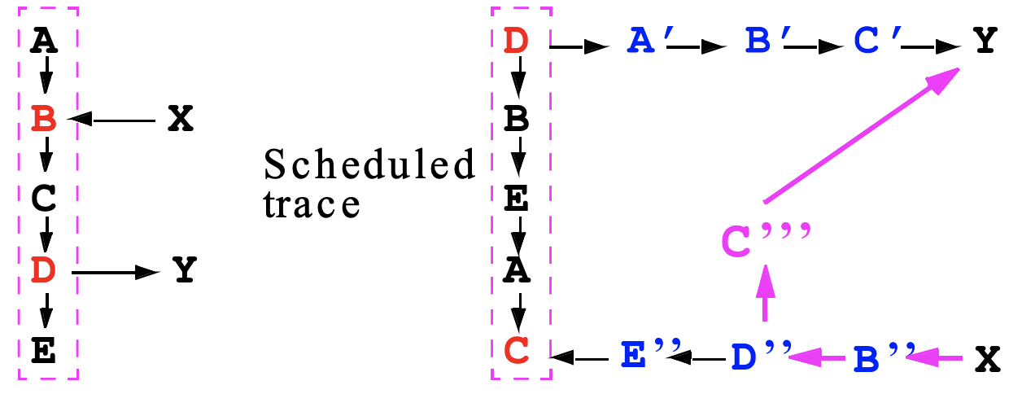
Fixup Code
copy instructions to ensure correctness of all paths
scheduled
https://course.ece.cmu.edu/~ece447/s15/lib/exe/fetch.php?media=
onur-447-spring15-lecture16-systolicarrays-static-scheduling-afterlecture.pdf

Slide 196
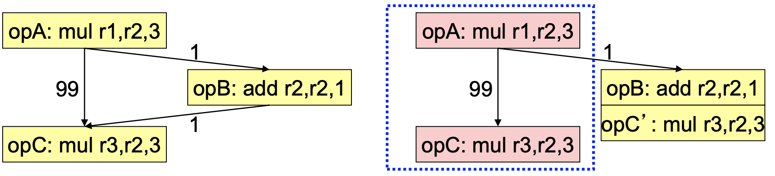
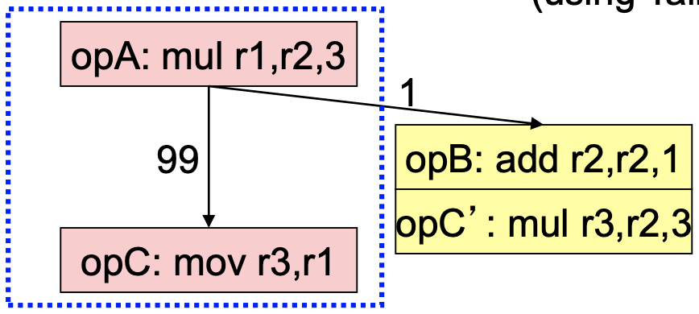
Superblock
Example with fixup code
Subexpression elimination
https://course.ece.cmu.edu/~ece447/s15/lib/exe/fetch.php?media=
onur-447-spring15-lecture16-systolicarrays-static-scheduling-afterlecture.pdf

Slide 197
How to handle branches?
when you have to

Slide 198
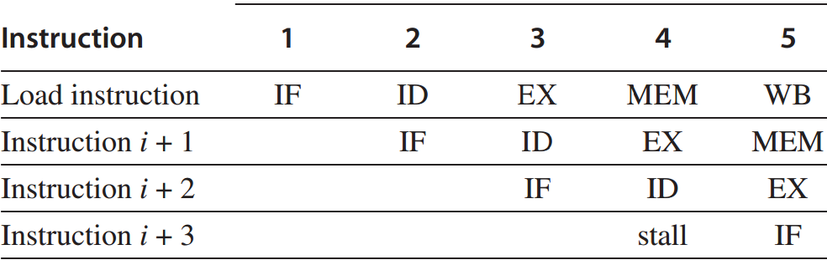
Control Hazard
branches and jumps
Branch hazard
a branch may or may mot change PC to other values other than PC+4;
taken branch: changes PC to its target address;
untaken branch: falls through to PC+4;
PC is not changed till the end of ID;
Notes:
A control hazard happens to branches and jumps. In this lecture, we focus only on branches.
Its main reason is that a branch may or may not change program counter to other values other than PC+4 but the change is available till the end of ID clock cycle.
If a branch instruction changes PC to its target address, it’s called a taken branch. Otherwise, it’s called untaken and falls through directly to the next instruction.

Slide 199
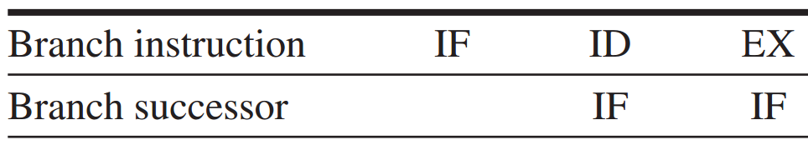
Branch Hazard
Redo IF
If the branch is untaken,
the stall is unnecessary.
essentially a stall
Notes:
Therefore, the IF running in parallel with the branch’s ID clock cycle may fetch a wrong instruction.
A simple solution is to redo IF, which is essentially a stall. However, if the branch is untaken, the stall is absolutely unnecessary.

Slide 200
Branch Hazard
Redo IF
If the branch is untaken,
the stall is unnecessary.
One stall cycle per branch leads to a 10%~30% perf loss.
essentially a stall
Notes:
One stall cycle for every branch will yield a performance loss of 10% to 30% depending on the branch frequency.
So we need to examine some techniques to deal with this loss.

Slide 201
Branch Hazard: Solutions
4 simple compile time schemes – 1
Freeze or flush the pipeline
hold or delete any instructions after the branch till the branch dst is known;
Notes:
There are four more solutions to branch hazard.
The first one is freeze or flush the pipeline. It simply holds or deletes any instruction after the branch till the branch destination is known.
In this case, the branch penalty is fixed and cannot be reduced by software.

Slide 202
Branch Hazard: Solutions
4 simple compile time schemes – 1
Freeze or flush the pipeline
hold or delete any instructions after the branch till the branch dst is known;
fixed penalty regardless of branch effectiveness;
Notes:
There are four more solutions to branch hazard.
The first one is freeze or flush the pipeline. It simply holds or deletes any instruction after the branch till the branch destination is known.
In this case, the branch penalty is fixed and cannot be reduced by software.

Slide 203
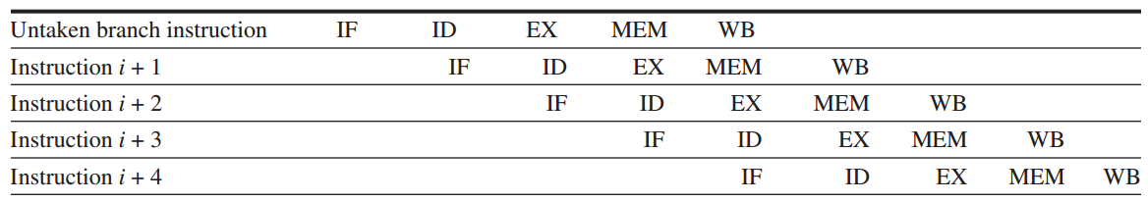
Branch Hazard: Solutions
4 simple compile time schemes – 2
Predicted-untaken / not-taken
simply treat every branch as untaken;
Notes:
The second scheme is predicated-untaken. It simply treats every branch as untaken.
When the branch is really untaken, the pipelining proceeds as if no hazard exists.

Slide 204
Branch Hazard: Solutions
4 simple compile time schemes – 2
Predicted-untaken / not-taken
simply treat every branch as untaken;
when the branch is untaken,
pipelining as if no hazard.
Notes:
The second scheme is predicated-untaken. It simply treats every branch as untaken.
When the branch is really untaken, the pipelining proceeds as if no hazard exists.

Slide 205
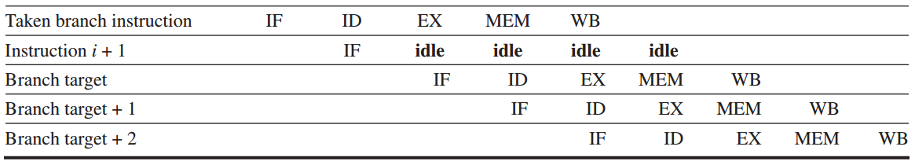
Branch Hazard: Solutions
4 simple compile time schemes – 2
Predicted-untaken
but if the branch is taken:
turn fetched instr into a no-op (idle);
restart the IF at the branch target addr
Notes:
But if the branch is taken, the processor will idle the fetched instruction and continue to process the instruction at the branch target address.

Slide 206
Branch Hazard: Solutions
4 simple compile time schemes – 3
Predicted-taken
simply treat every branch as taken;
what decides its effectiveness?
Notes:
Opposite to predicted-untaken, another scheme is predicted-taken. It simply treats every branch as taken.
It doesn’t apply to the five-stage pipeline, so we don’t cover its details in this lecture.
What decides its effectiveness:
i.e., what behavior of branch decides whether predicted-taken strategy benefits program execution speed?
(at least branch target should be known for early action on branches)

Slide 207
Branch Hazard: Solutions
4 simple compile time schemes – 3
Predicted-taken
simply treat every branch as taken;
not apply to the five-stage pipeline (with branches completed in ID as in 5th ed);
Notes:
Opposite to predicted-untaken, another scheme is predicted-taken. It simply treats every branch as taken.
It doesn’t apply to the five-stage pipeline that completes branch in ID, so we don’t cover its details in this lecture.

Slide 208
Branch Hazard: Solutions
4 simple compile time schemes – 3
Predicted-taken
simply treat every branch as taken;
apply to scenarios when branch target addr is known before branch outcome (e.g., test branch condition in EX – ALU as in 6th ed);
Notes:
Opposite to predicted-untaken, another scheme is predicted-taken. It simply treats every branch as taken.
It doesn’t apply to the five-stage pipeline that completes branch in ID, so we don’t cover its details in this lecture.

Slide 209
Branch Hazard: Solutions
4 simple compile time schemes – 4
Delayed branch
delay the branch execution after the next instruction;
pipelining sequence:
branch instruction
sequential successor
branch target if taken
Branch delay slot
the next instruction
that is independent of
the branch target
executed whether or not the branch is taken
Notes:
The fourth scheme is delayed branch.
It directly delays the branch execution after the next instruction. In other words, it executes the next instruction first whether or not the branch is taken.

Slide 210
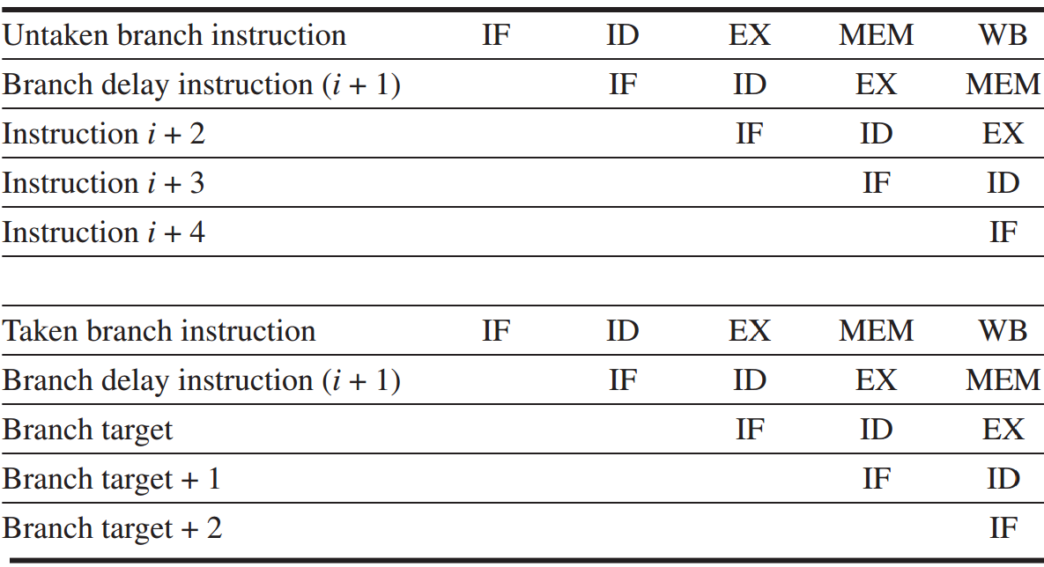
Branch Hazard: Solutions
Delayed branch
Notes:
Here are examples of delaying an untaken branch and a taken branch.
We can see that they have the same pipelining efficiency, because the sequential successor in the branch delay slot is executed whether or not the branch is taken.

Slide 211
Branch Hazard: Solutions
Example
20-stage pipeline
1 out of 5 instructions is a branch
5-instruction block ends with a branch
How long to fetch 500 instructions given various prediction accuracy?
100%
99%
90%
https://safari.ethz.ch/digitaltechnik/spring2021/lib/exe/fetch.php?media=
onur-digitaldesign_comparch-2021-lecture17b-branch-prediction-i-afterlecture.pdf

Slide 212
Branch Hazard: Solutions
Example
20-stage pipeline
1 out of 5 instructions is a branch
5-instruction block ends with a branch
How long to fetch 500 instructions given various prediction accuracy?
100%: 1 instr per CC → 500 CC
99%
90%
https://safari.ethz.ch/digitaltechnik/spring2021/lib/exe/fetch.php?media=
onur-digitaldesign_comparch-2021-lecture17b-branch-prediction-i-afterlecture.pdf

Slide 213
Branch Hazard: Solutions
Example
20-stage pipeline
1 out of 5 instructions is a branch
5-instruction block ends with a branch
How long to fetch 500 instructions given various prediction accuracy?
100%: 1 instr per CC → 500 CC
99%: 500 + 20 x 1 = 520 CC
90%

Slide 214
Branch Hazard: Solutions
Example
20-stage pipeline
1 out of 5 instructions is a branch
5-instruction block ends with a branch
How long to fetch 500 instructions given various prediction accuracy?
100%: 1 instr per CC → 500 CC
99%: 500 + 20 x 1 = 520 CC
90%: 500 + 20 x 10 = 700 CC

Slide 215
Branch Hazard: Solutions
Example 20% branches among all instructions
branch prediction accuracy | branch resolved in 3rd stage | branch resolved in 10th stage
50%
90%
https://www.youtube.com/watch?v=wse0huBFfZA

Slide 216
Branch Hazard: Solutions
Example 20% branches among all instructions
branch prediction accuracy | branch resolved in 3rd stage | branch resolved in 10th stage
50% | 1 + 0.2x0.5x2 | 1 + 0.2x0.5x9
90% | 1 + 0.2x0.1x2 | 1 + 0.2x0.1x9
https://www.youtube.com/watch?v=wse0huBFfZA

Slide 217
Branch Hazard: Solutions
Example 20% branches among all instructions
The deeper branch resolution, the more performance gain with higher branch prediction accuracy
branch prediction accuracy | branch resolved in 3rd stage | branch resolved in 10th stage
50% | 1.2 | 1.9
90% | 1.04 | 1.18
https://www.youtube.com/watch?v=wse0huBFfZA

Slide 218
Fetch Stage with BTB & DP
how hardware dynamically helps?
Direction Predictor (taken?)
taken?
PC + inst size
Next Fetch
Address
Program
Counter
hit?
address of the
current branch
target address
Cache of Target Addresses (BTB: Branch Target Buffer)
https://safari.ethz.ch/digitaltechnik/spring2021/lib/exe/fetch.php?media=
onur-digitaldesign_comparch-2021-lecture17b-branch-prediction-i-afterlecture.pdf

Slide 219
Review
Integer & floating-point pipelining
Out-of-order execution
Hazard & forwarding
Static scheduling

Slide 220
Appendix C
Chapter 3.1-3.2
Appendix H
Notes:
The following content corresponds to chapter 3 (mostly 3.1 – 3.2)
atop the basic working principles of pipelining we have learnt from Appendix C.

Slide 221

Chapter 4
further reading

Slide 222

Chapters 5&6
further reading
Notes:
For multicycle datapath
each instruction into a series of steps corresponding to the functional unit operations that were needed. We can use these steps to create a multicycle implementation. In a multicycle implementation, each step in the exe- cution will take 1 clock cycle. The multicycle implementation allows a functional unit to be used more than once per instruction, as long as it is used on different clock cycles. This sharing can help reduce the amount of hardware required. The ability to allow instructions to take different numbers of clock cycles and the ability to share functional units within the execution of a single instruction are the major advantages of a multicycle design.

Slide 223
Further Reading
Static Branch Prediction by Onur Mutlu
Appendix C – Pipelining
Appendix H.3 – Scheduling and Structuring Code for Parallelism

Slide 224
?

Slide 225

Thank You
be empathetic
every face along the boulevard
is a dreamer just like you

Slide 226
#What’s More
What Matters More than Your Talents? by Jeff Bezos

